Slide 1

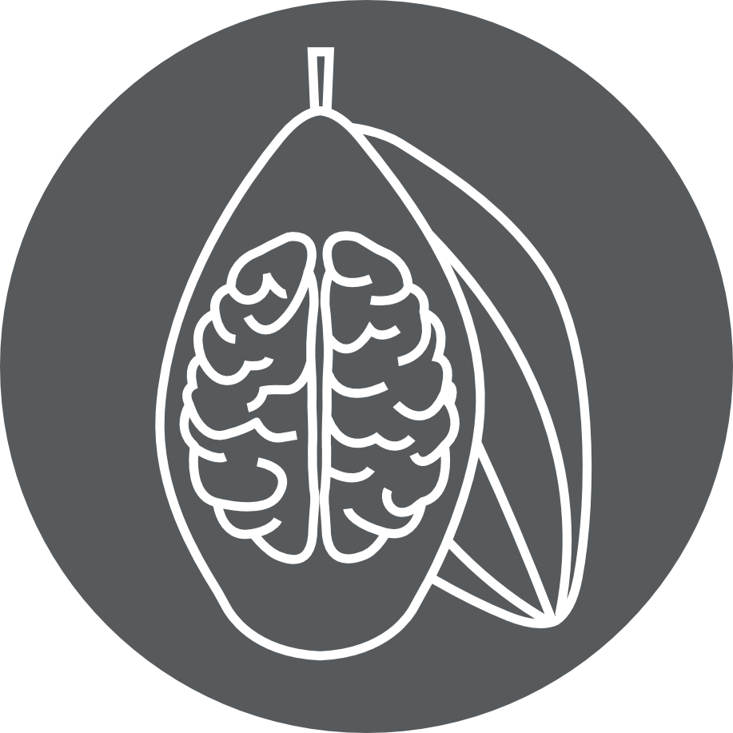
Affective Neuroscience | Fall 2020
Lecture 03
Lecture 03
Affective brain systems
CHOONG-WAN WOO | COCOAN lab | http://cocoanlab.github.io
Many slides are modified from Tor D. Wager’s slides

Slide 2
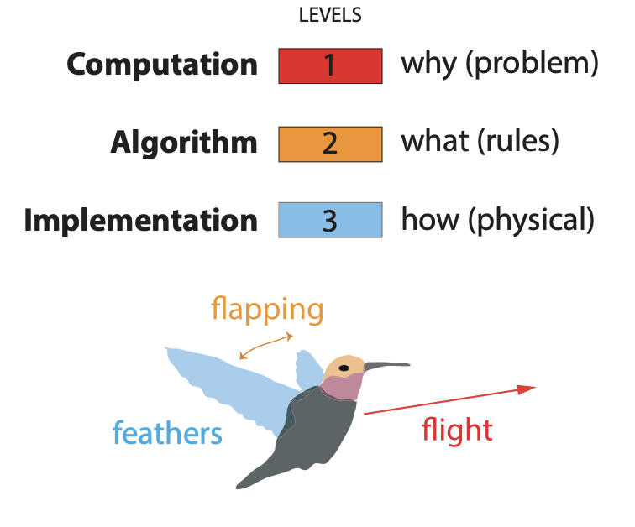
Let’s start with the big picture
Marr’s three level of analysis (or level of abstraction)
Functional, ecological
Algorithmic, computational
Implementation, neurobiological
CHOONG-WAN WOO | COCOAN lab | http://cocoanlab.github.io
Krakauer et al., 2017, Neuron

Slide 3
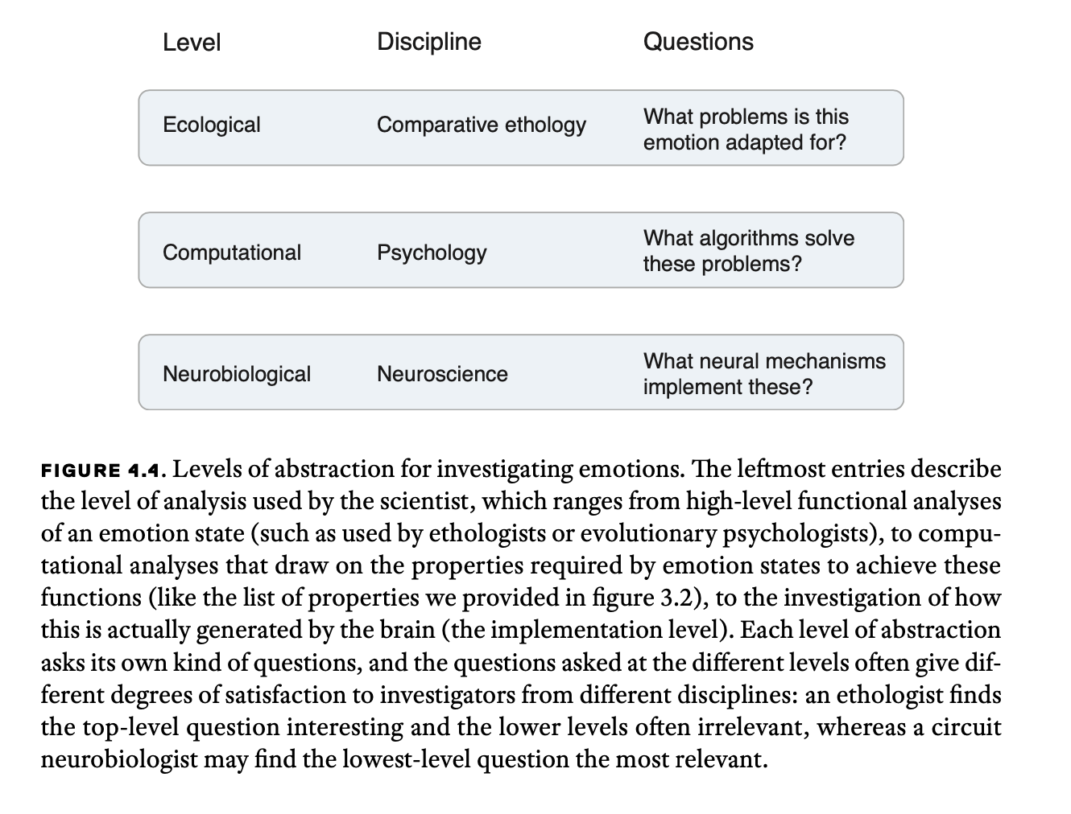
Let’s start with the big picture
Marr’s three level of analysis (or level of abstraction)
CHOONG-WAN WOO | COCOAN lab | http://cocoanlab.github.io
Krakauer et al., 2017, Neuron

Slide 4
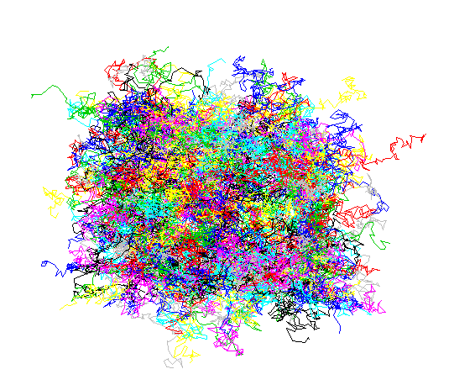
The problem of abstraction:
Is there a privileged level of abstraction?
To fully understand emotions:
No
For different fields of science,
Yes
CHOONG-WAN WOO | COCOAN lab | http://cocoanlab.github.io

Slide 5
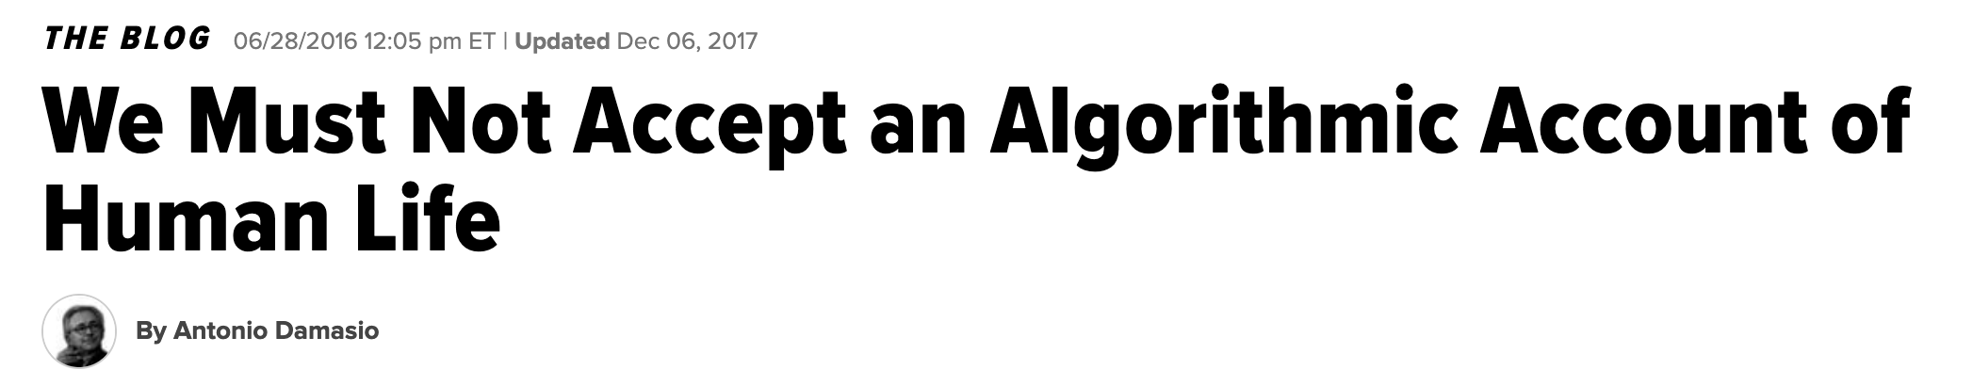
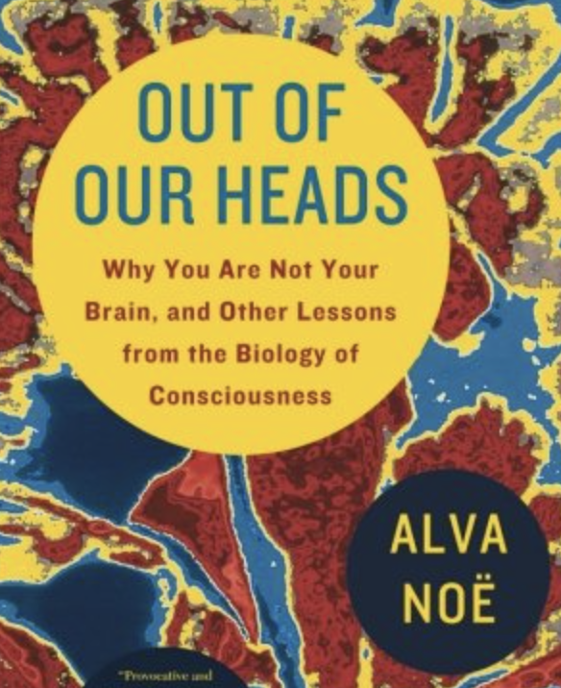
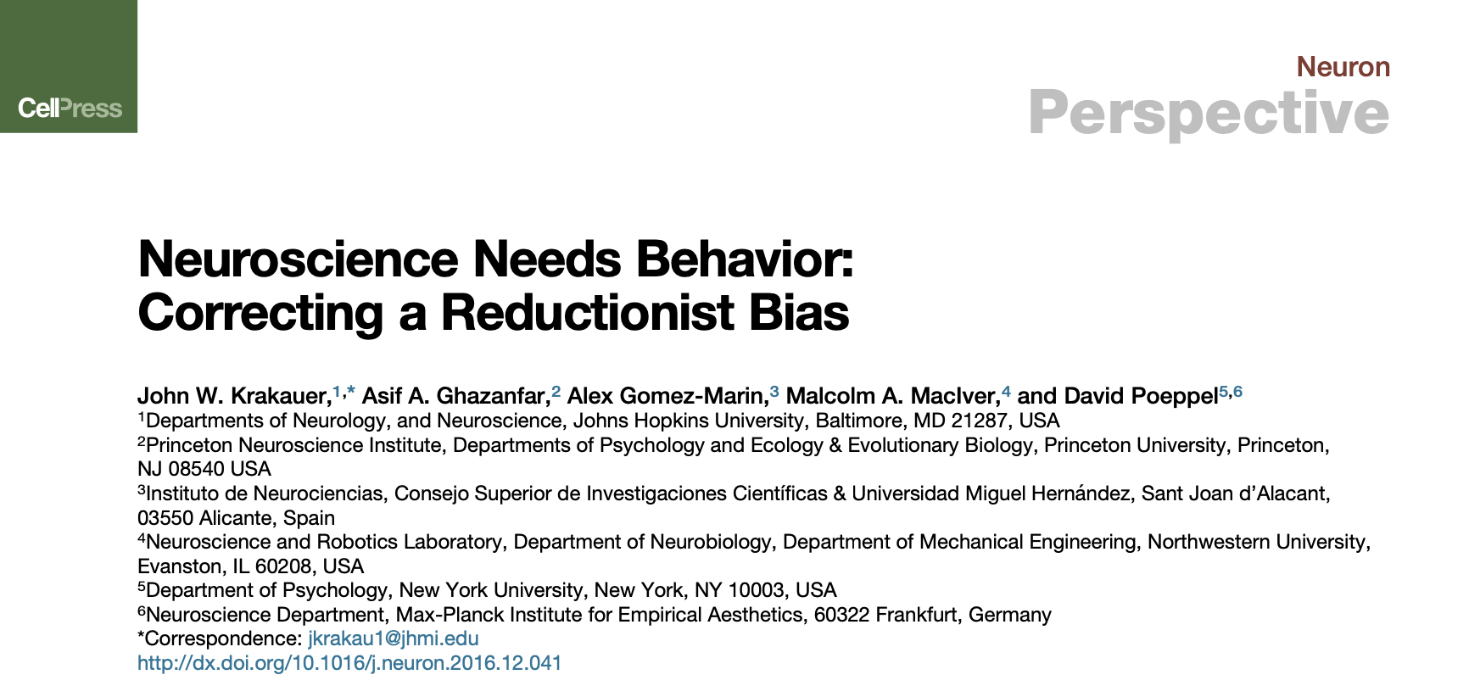
In neuroscience?
https://www.huffpost.com/entry/algorithmic-human-life_b_10699712
Mechanistic explanation!
=?? identifying more neurobiological components (regions or pathways) of the black-box of a function
But see these:
CHOONG-WAN WOO | COCOAN lab | http://cocoanlab.github.io

Slide 6
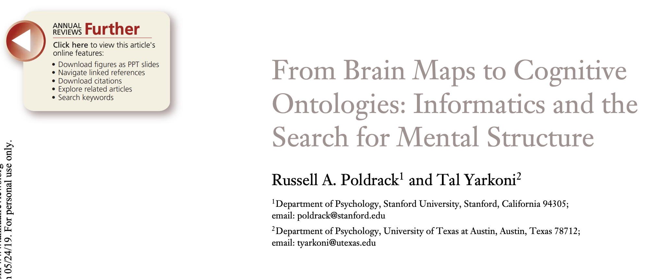
In neuroscience?
Mechanism
Causality
Inter-relationships among high-dimensional components at the multiple levels
We need both approaches:
Intervention studies (e.g., optogenetics)
Big data approach, multi-level, systems-level
e.g., turning off (or lesion) vs. observing natural firing patterns
Reverse inference – more precise mapping requires better sampling scheme (e.g., large-scale, multi-component approach, cognitive ontology)
What can fMRI research offer?
CHOONG-WAN WOO | COCOAN lab | http://cocoanlab.github.io

Slide 7
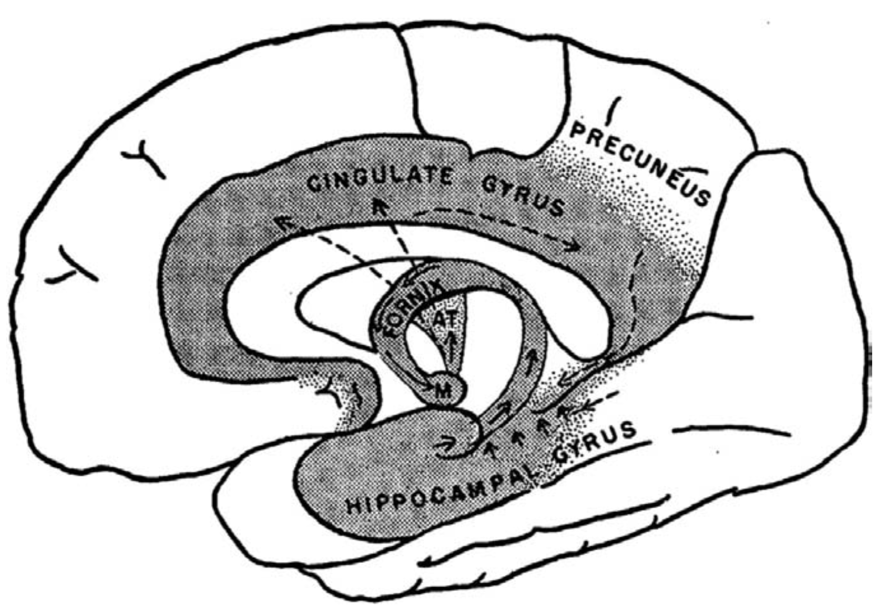
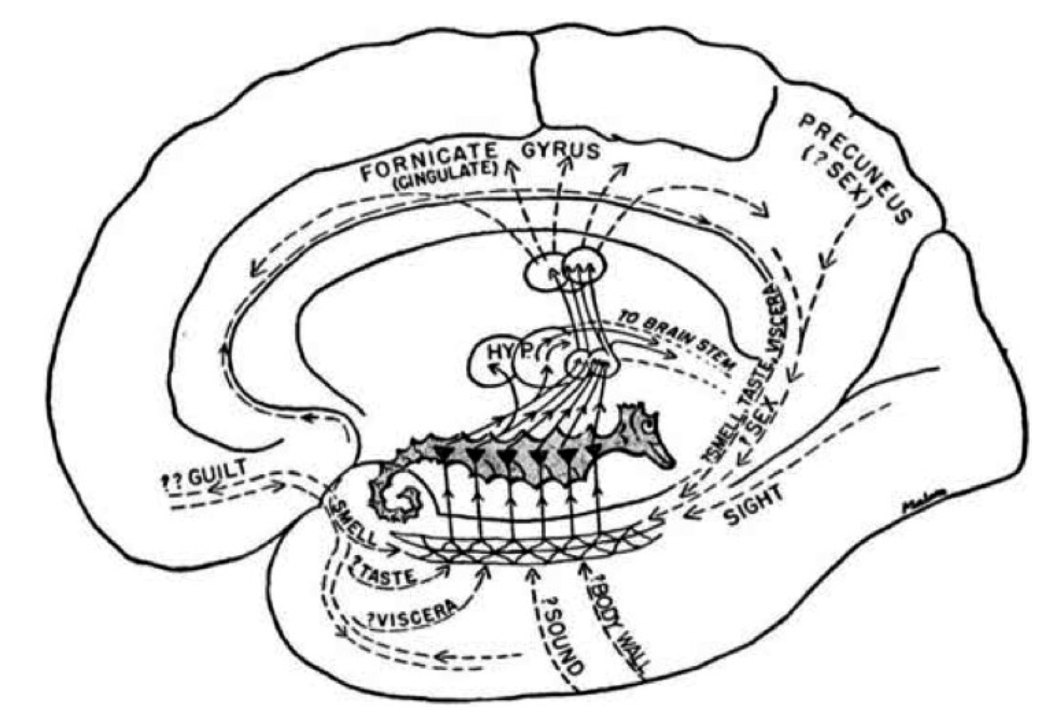
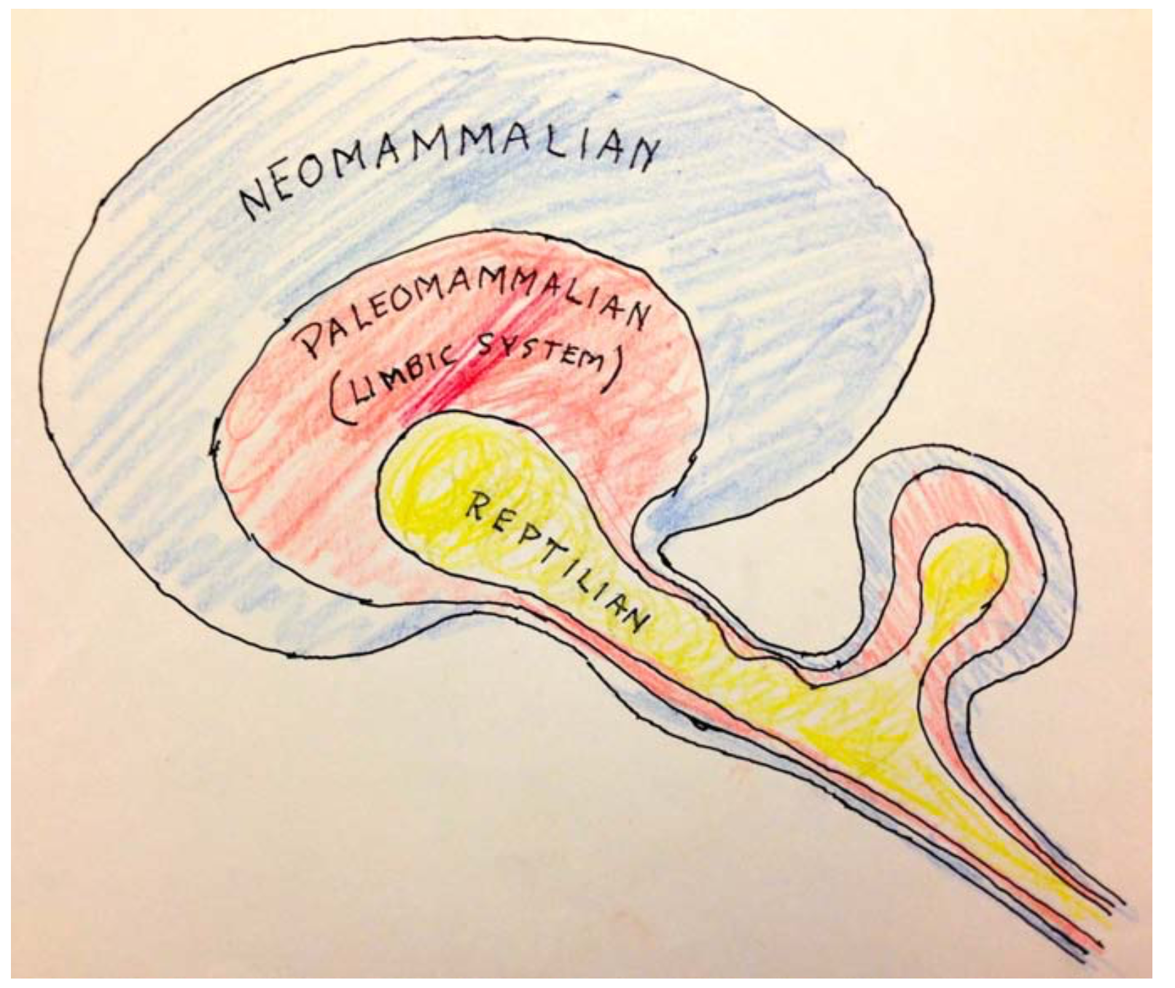
Lecture 03
Paul MacLean’s visceral brain/limbic system
MacLean’s original limbic system was centered on medial regions, and focused on the hippocampus
The hippocampus is now thought to play a more complex, indirect role in affect
Visceral brain
from Paul D. MaClean, “Psychosomatic disease and the visceral brain. recent developments bearing on the PAPEZ theory of emotion,” psychosomatic medicine, 1949
Pogliano 2017
CHOONG-WAN WOO | COCOAN lab | http://cocoanlab.github.io

Slide 8
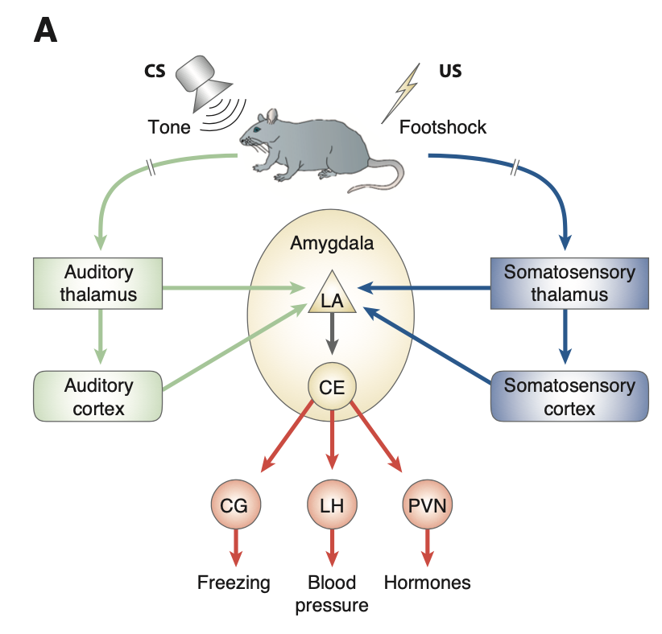
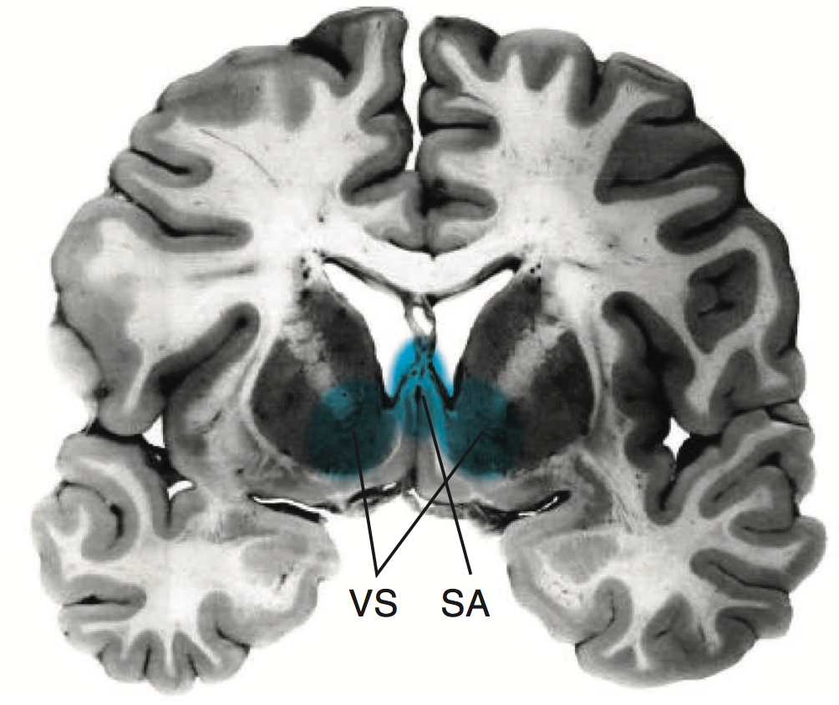
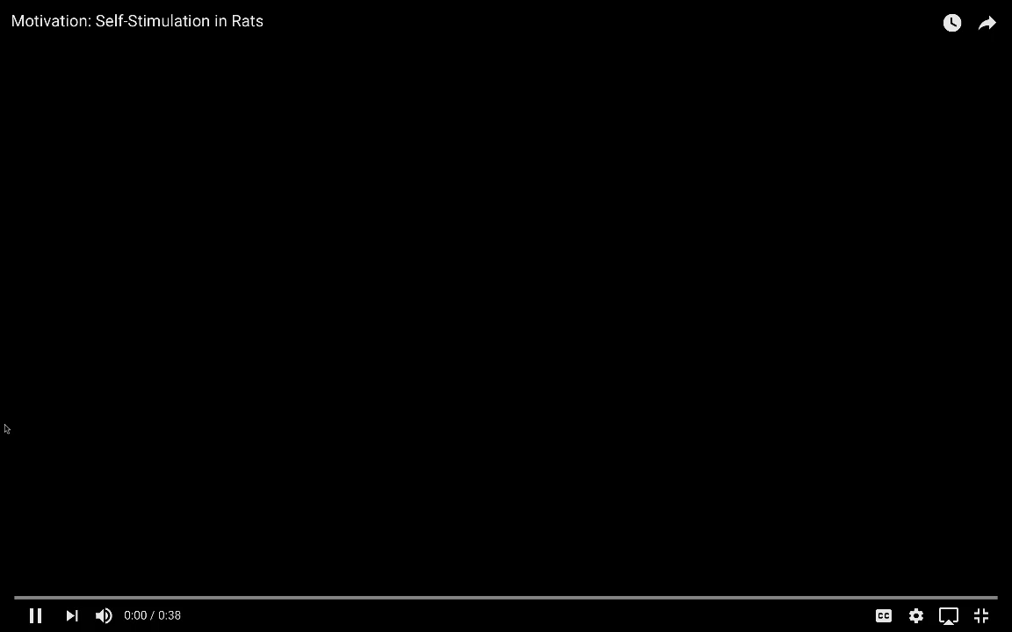
Lecture 03
Amygdala, lateral hypothalamus, ventral striatum, etc.
Amygdala for fear conditioning
Lateral hypothalamus for animal self-stimulating (Pleasure center; Olds and Milner) http://alfre.dk/the-pleasure-center/
Ventral striatum for anticipating monetary reward
SA: septal area
VS: ventral striatum (nucleus accumbens)
Medina et al., 2002, NRN
CHOONG-WAN WOO | COCOAN lab | http://cocoanlab.github.io

Slide 9
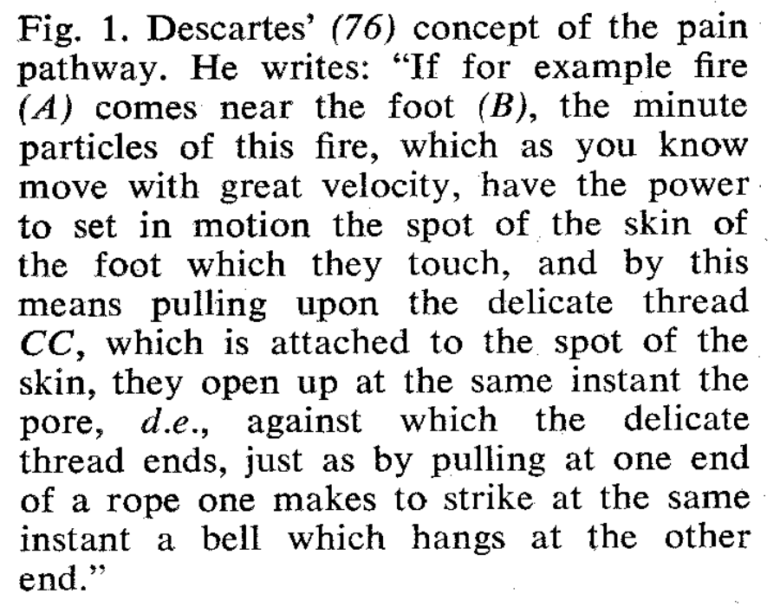
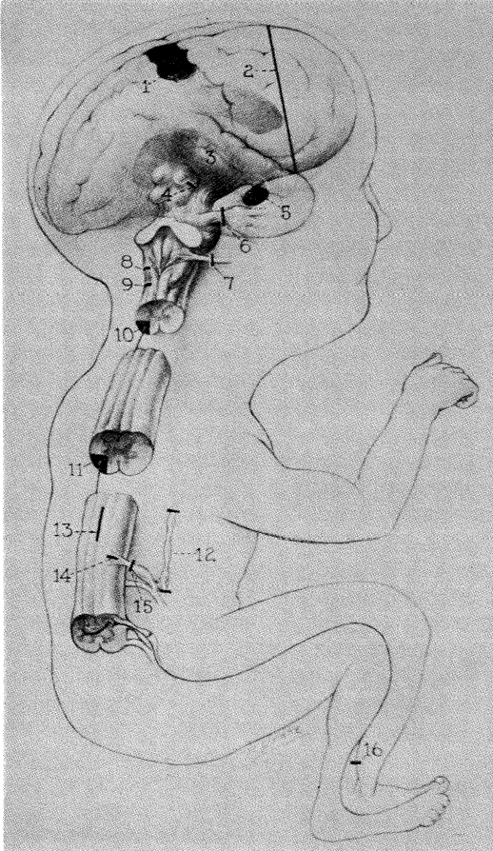
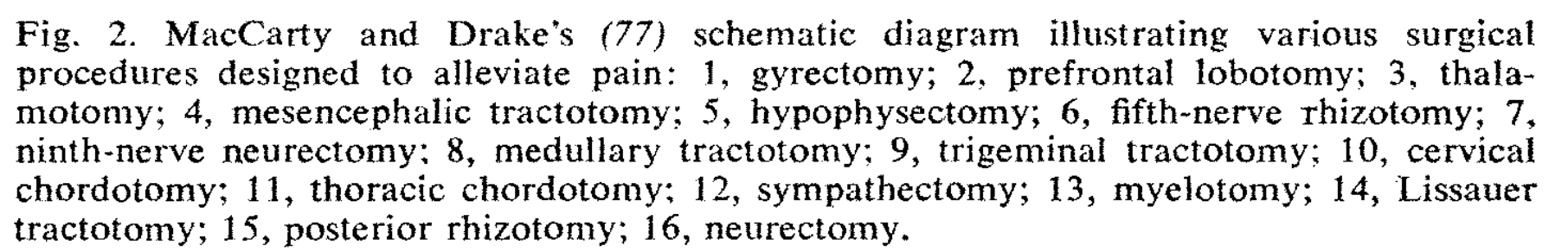
Melzack and Wall, Science, 1965 Lecture 03
For pain:
Surgical interventions for pain
Gyrectomy (cingulotomy)
Frontal lobotomy
Thalamotomy
Mesencephalic tractotomy
Hypophysectomy (pituitary)
C.N. V
C.N. IX
Medullary tract
Trigeminal tract
10, 11 Spinal cord
Sympathetic ganglia
Crossing STT fibers
Zone of Lissauer
15, 16 Peripheral nerves or roots
Causal?
Obligatory?
Sufficient?
Selective benefits (they don’t always work!!)
Sometimes makes pain worse
CHOONG-WAN WOO | COCOAN lab | http://cocoanlab.github.io

Slide 10
Lecture 03
But necessity and sufficiency?
CHOONG-WAN WOO | COCOAN lab | http://cocoanlab.github.io

Slide 11
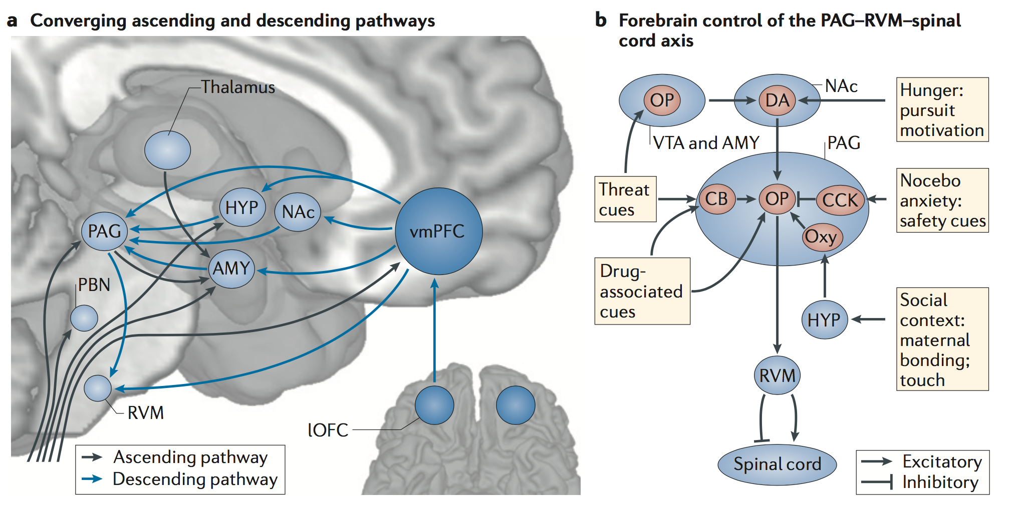
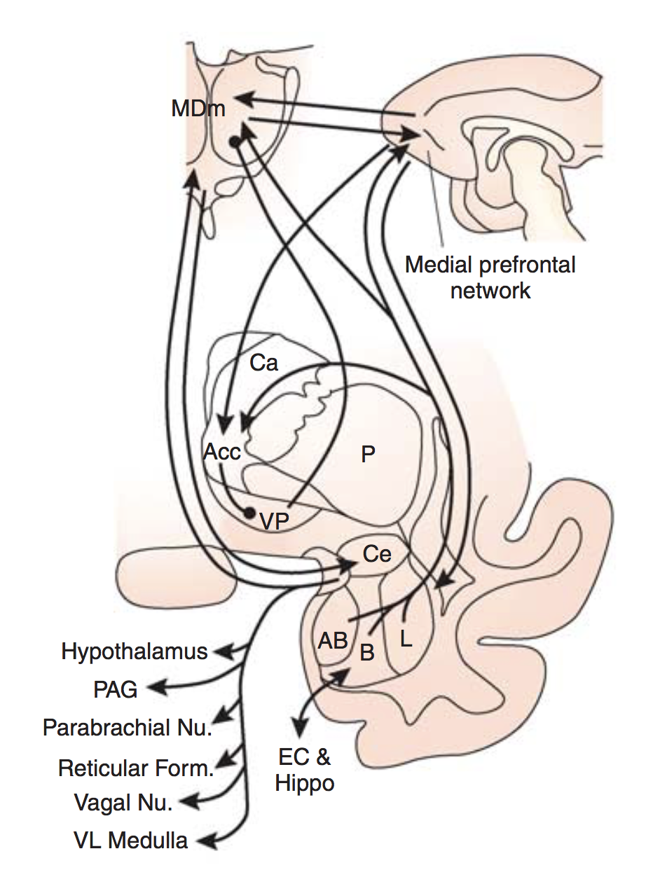
Lecture 03
Modern view of core affective circuits: Distributed brain systems
Strong network organization. E.g.: The amygdala and other forebrain regions regulate both cortex and brainstem.
Parallel circuits in different parts of medial PFC-striatum-amygdala-thalamus-brainstem
Summary of amygdaloid outputs
Price & Drevets 2010
Wager & Atlas 2015
CHOONG-WAN WOO | COCOAN lab | http://cocoanlab.github.io

Slide 12
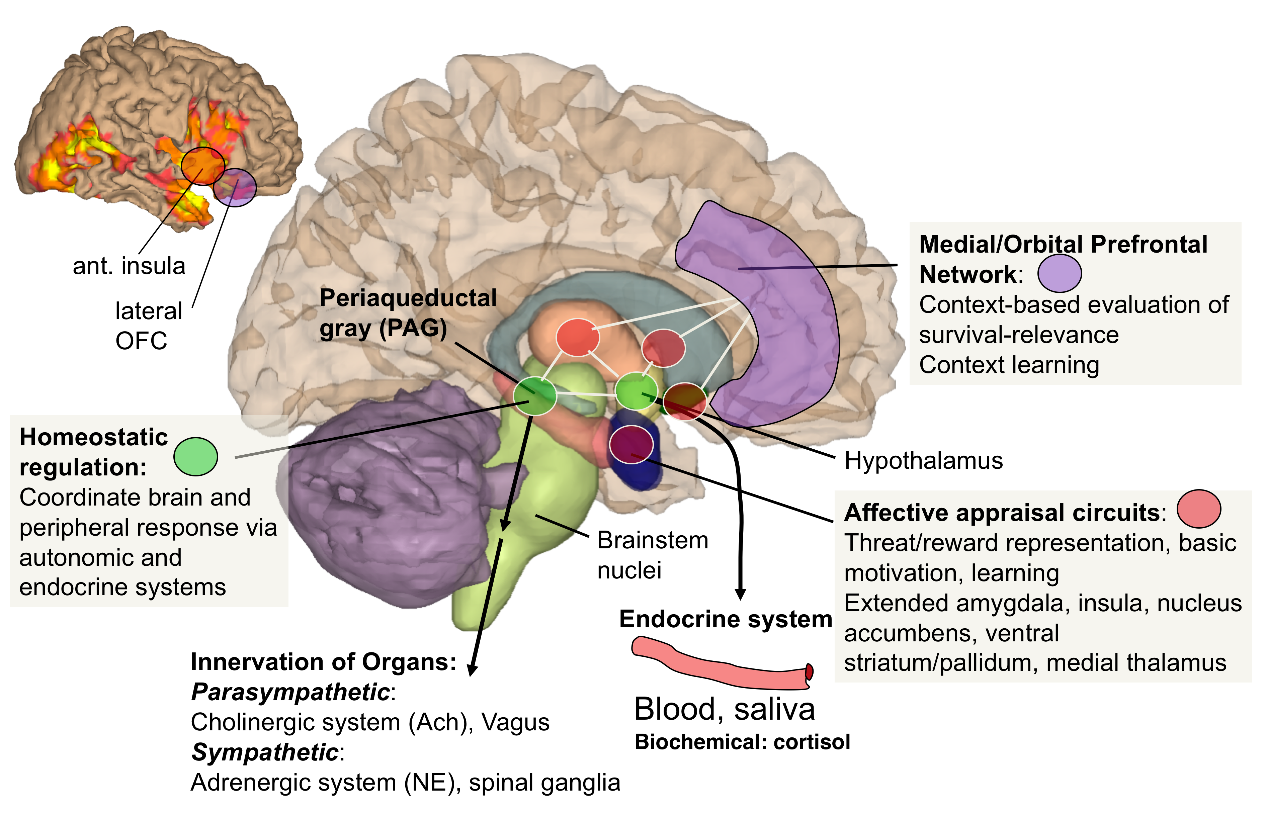
Lecture 03
Modern view of core affective circuits: Brain-body interaction
CHOONG-WAN WOO | COCOAN lab | http://cocoanlab.github.io

Slide 13
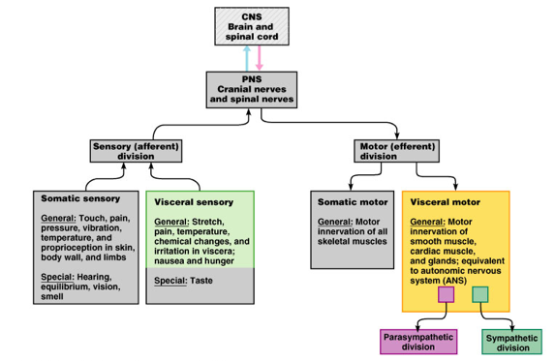
Lecture 03
Get to know the body-nervous system: Visceral sensory and motor
Each pathway is:
General or Special
Somatic or Visceral
Afferent or Efferent
ANS: peripheral nervous system pathways that regulate parameters of physiology generally not under conscious control (RED)
Has both visceral sensory (afferent) and motor (efferent) components
CHOONG-WAN WOO | COCOAN lab | http://cocoanlab.github.io

Slide 14
Lecture 03
Effector systems: Affective output
Three types:
1. Somatic motor
2. Autonomic
3. Chemical signaling
Subdivisions
Downstream effects:
Voluntary
Involuntary
Digestion
Metabolism
Circulation
Immune signaling (e.g., inflammation)
Health behaviors
Social behaviors
Sympathetic
Parasympathetic
Neuroendocrine
Pheromone
CHOONG-WAN WOO | COCOAN lab | http://cocoanlab.github.io

Slide 15
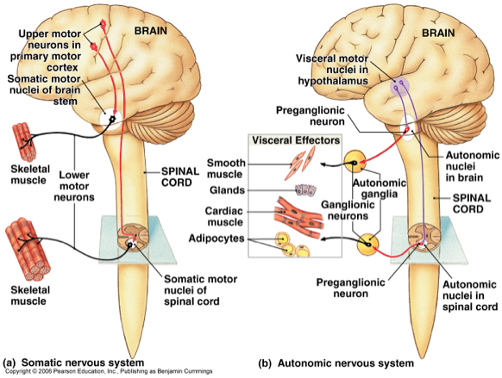
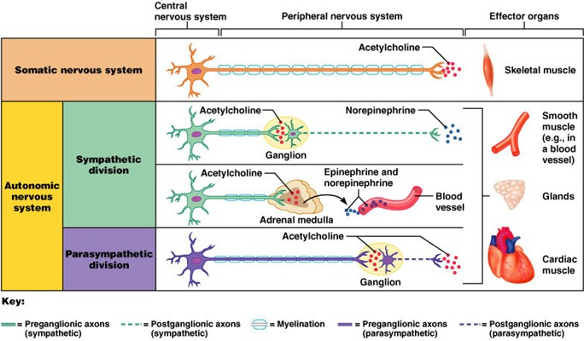
Lecture 03
Effector systems: Somatic and autonomic systems
Two types of nervous system outputs: Somatic and autonomic
Somatic: cell bodies of motor neurons in brain, spinal cord; behavior, skeletal motor control
Autonomic: cell bodies of motor neurons in pre-, post-ganglionic series; visceral (smooth) muscle, heart, glands, fat cells
CHOONG-WAN WOO | COCOAN lab | http://cocoanlab.github.io
Notes:
Multiple levels of motor control: There are many motor systems, not one motor system. Red nucleus Is also another Motor control system

Slide 16
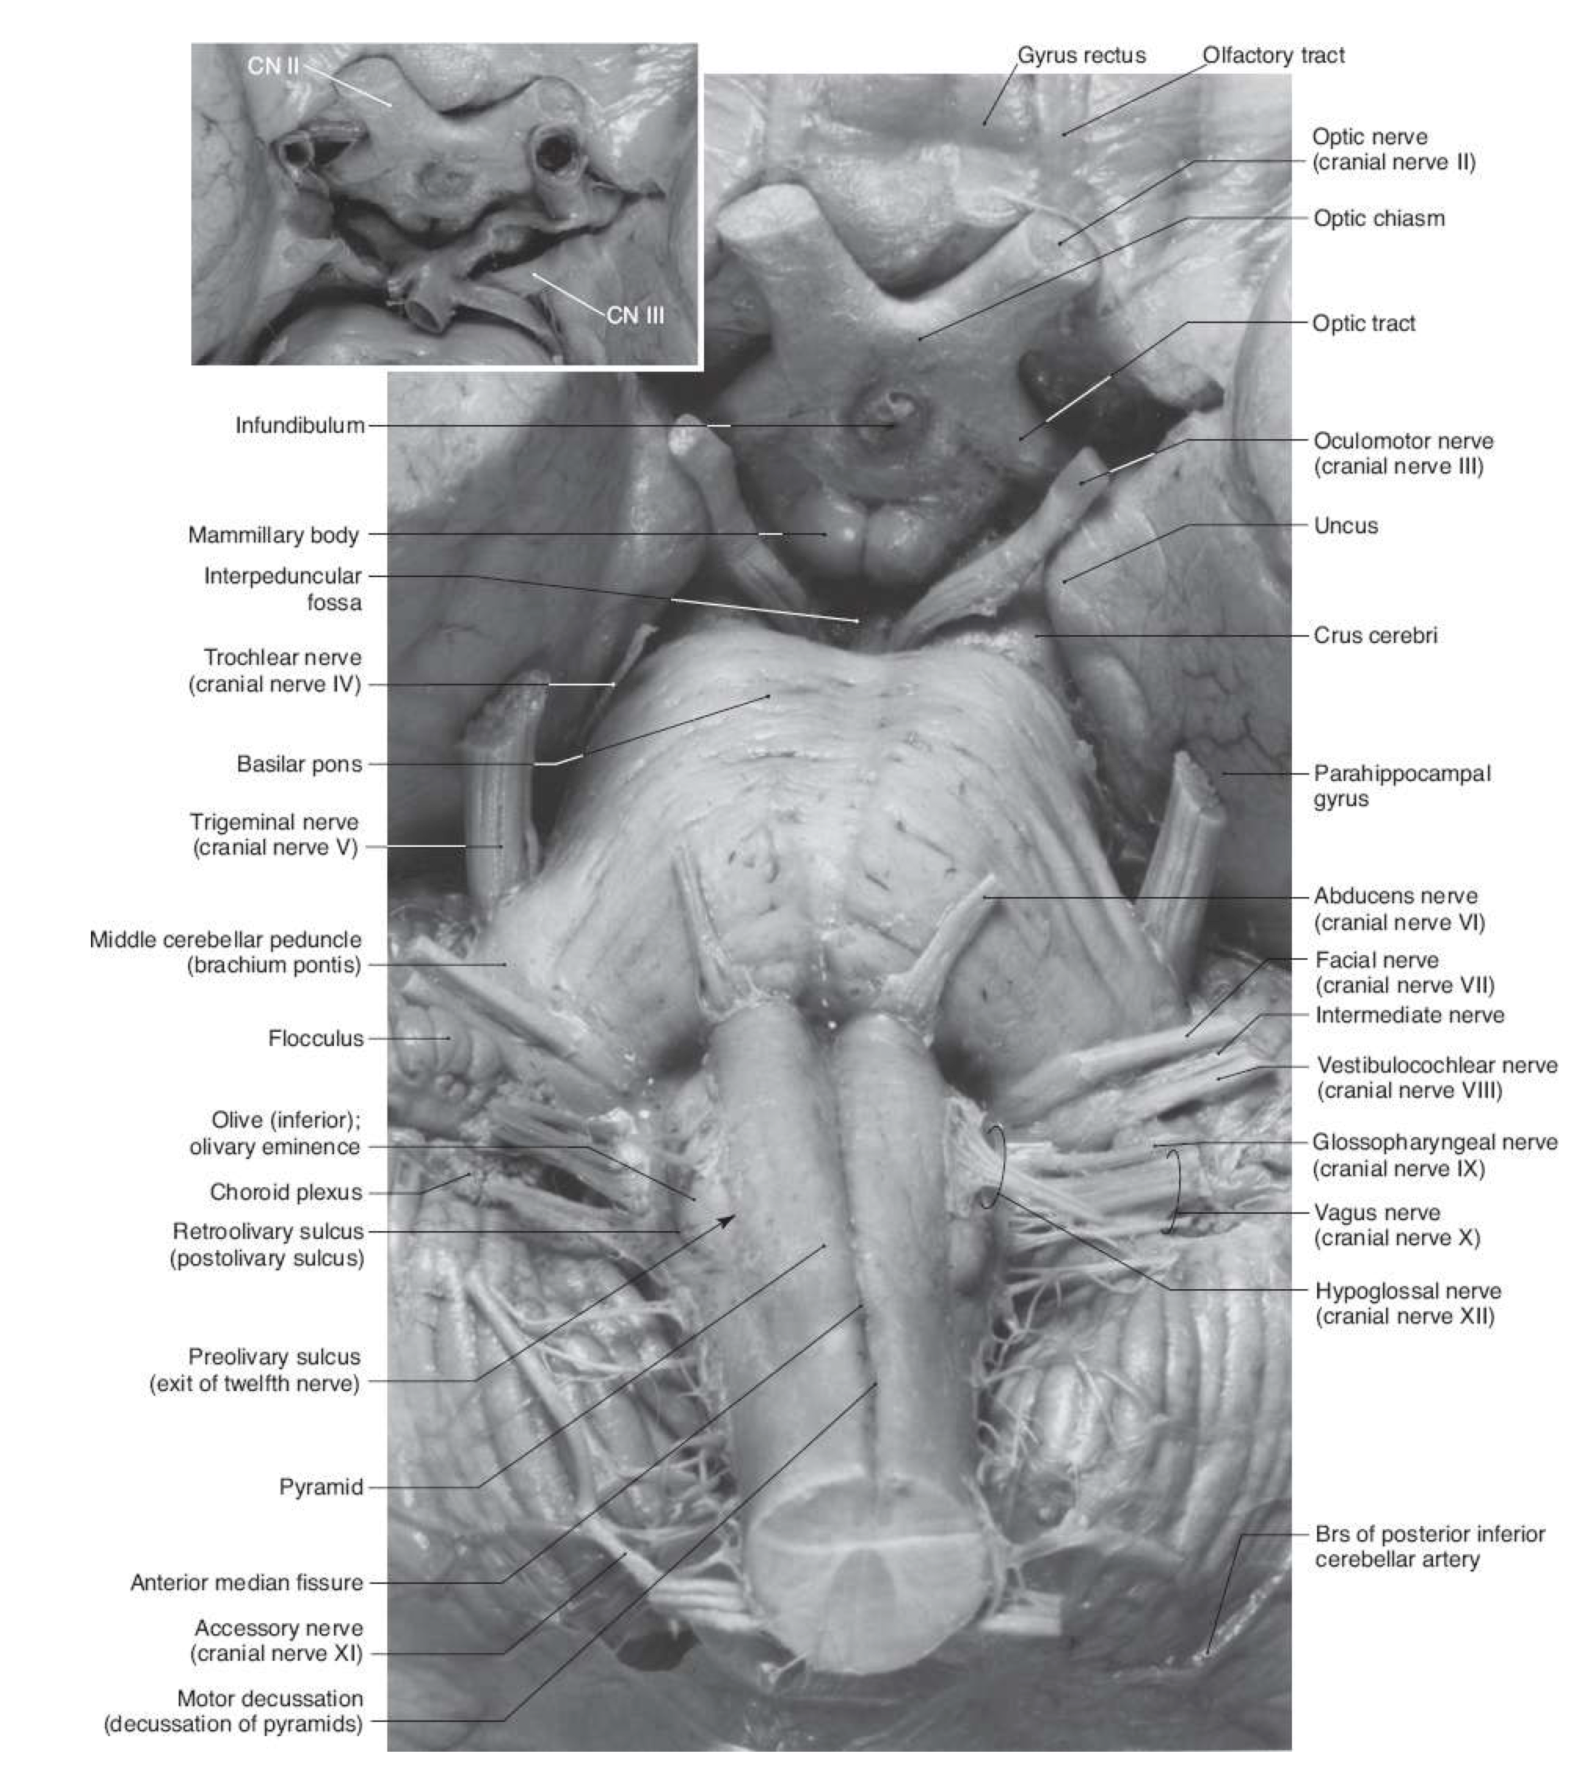
https://www.earthslab.com/anatomy/cranial-nerves/, Haines Lecture 02 | 031518
Cranial nerves
Afferent: To the brain
Efferent: From the brain
Somatic: Related to the body
Visceral: Related to internal organs
CHOONG-WAN WOO | COCOAN lab | http://cocoanlab.github.io

Slide 17
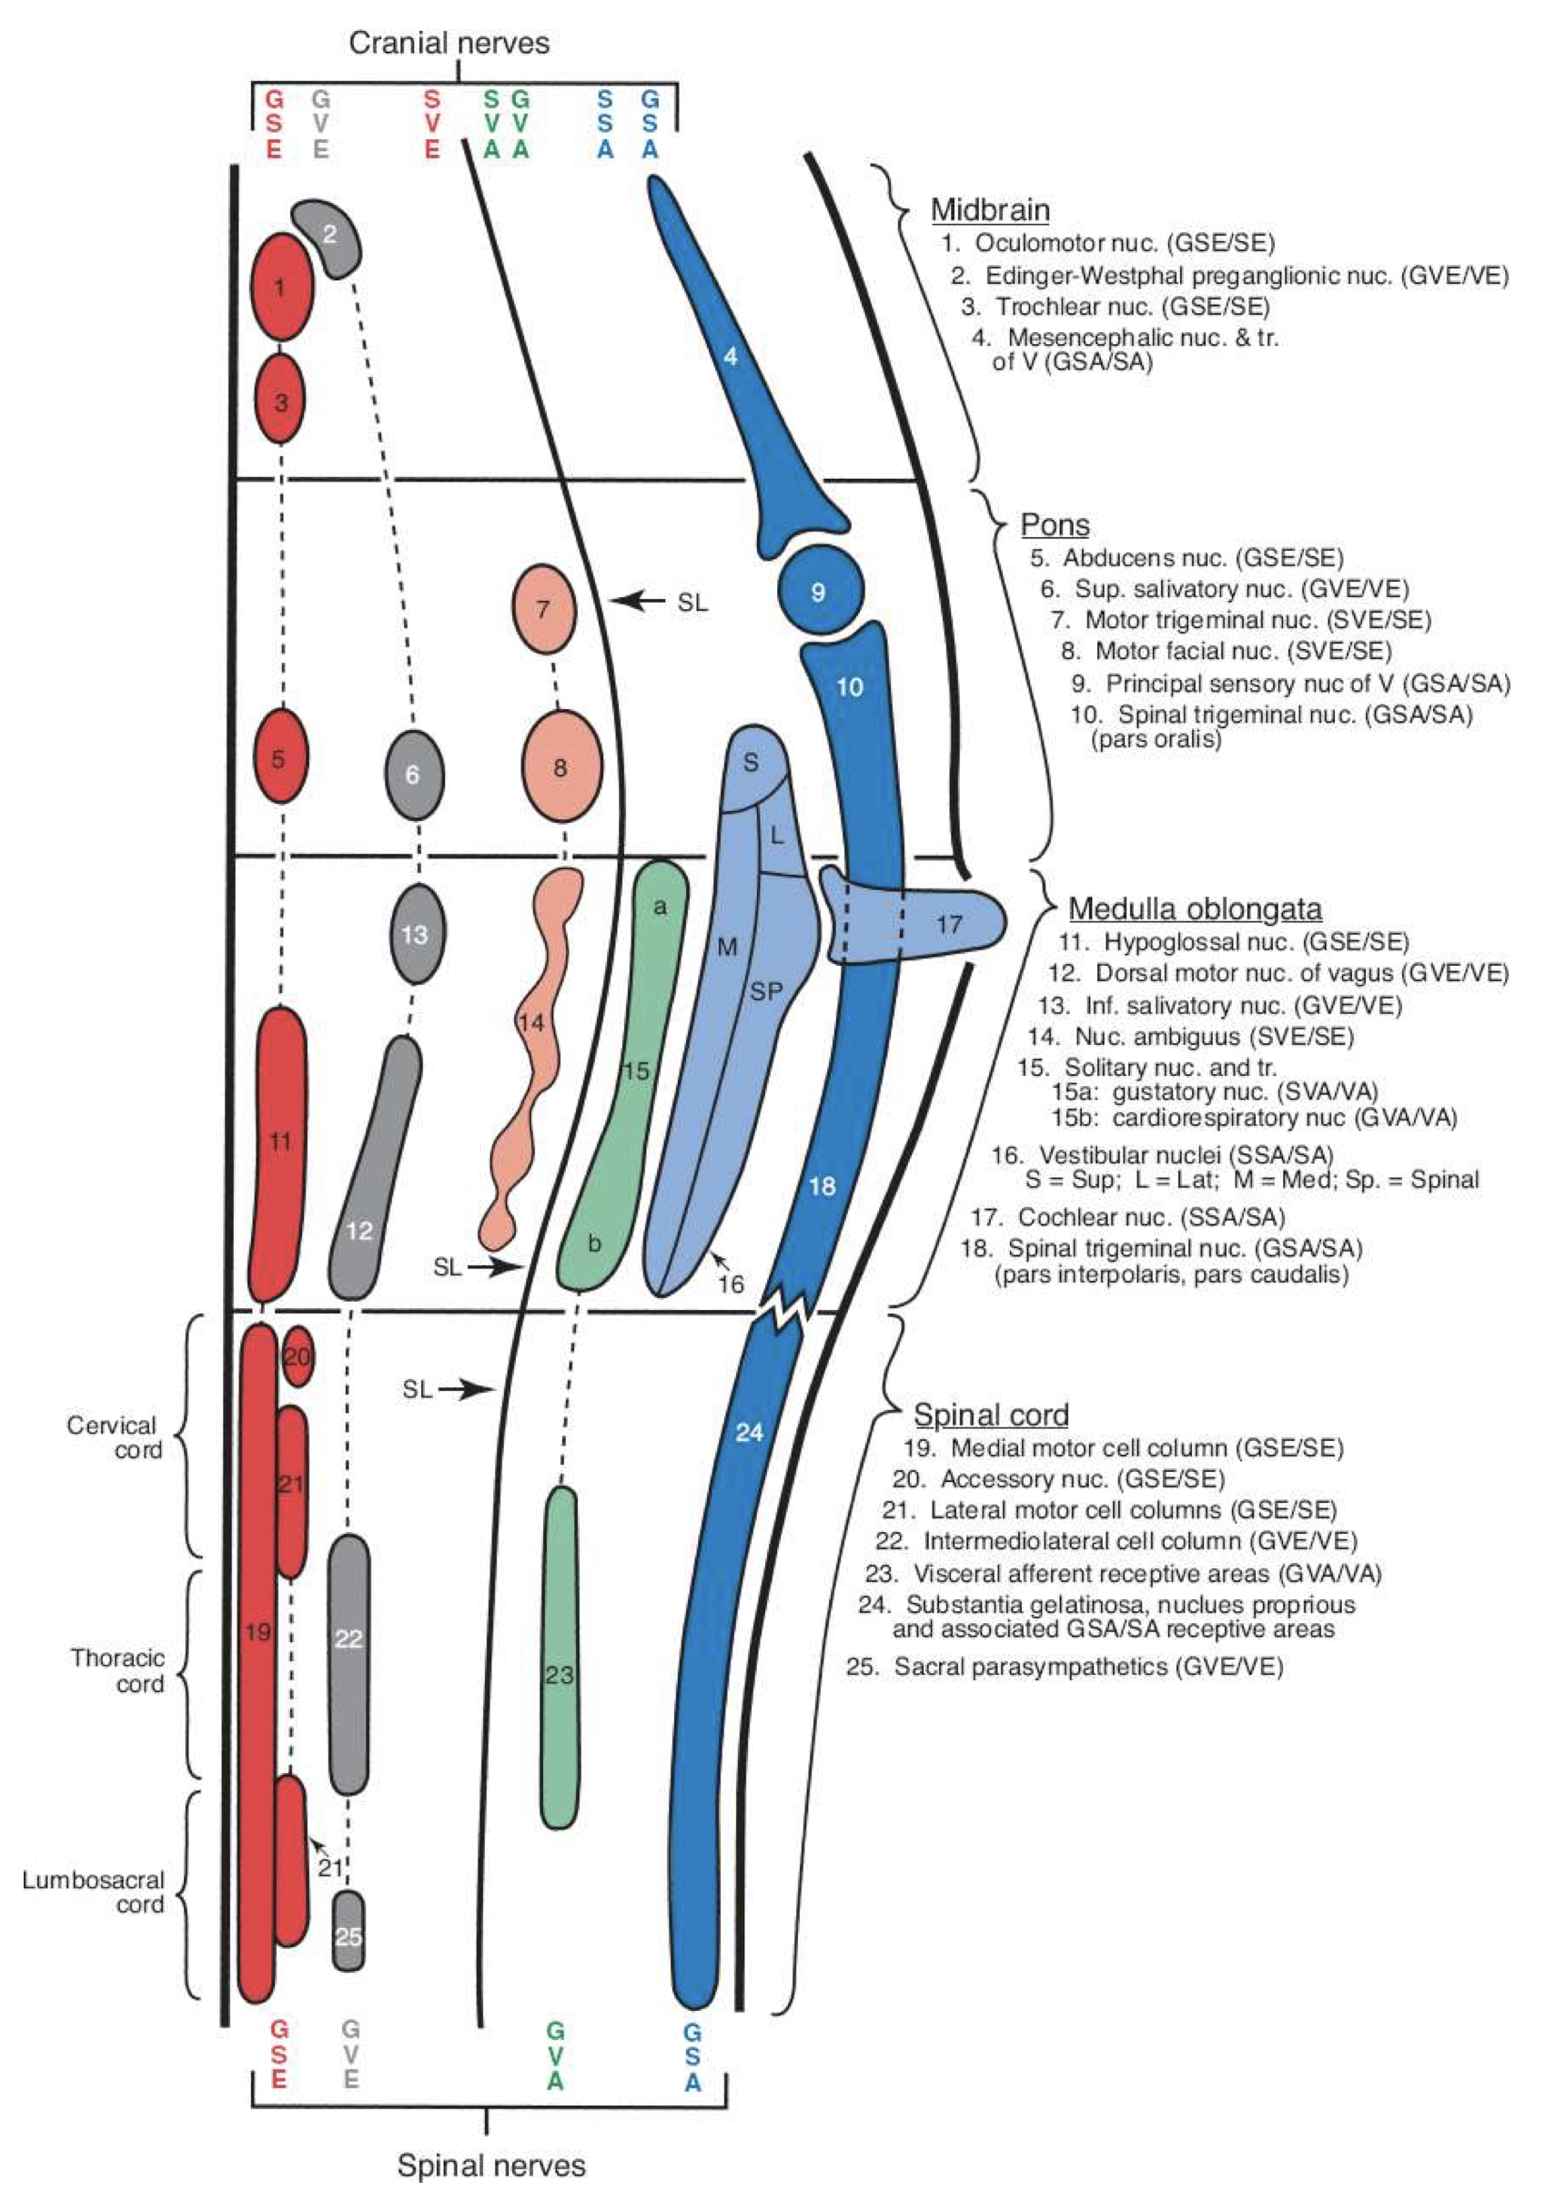
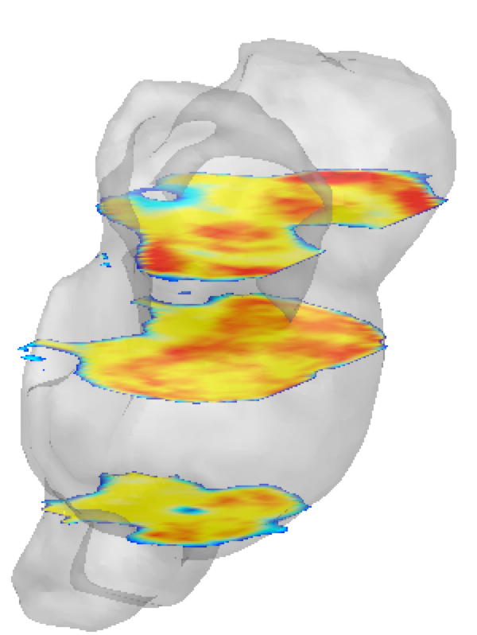
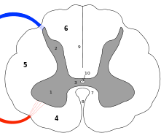
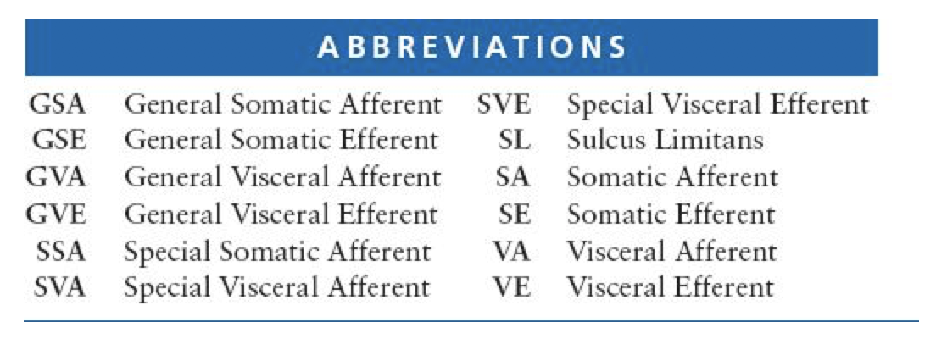
Lecture 03
Brainstem
Midbrain
12. DMN of Vagus (X)
Pons
15. Solitary nucleus (NTS)
Medulla
Spinal Cord
CHOONG-WAN WOO | COCOAN lab | http://cocoanlab.github.io
Notes:
The idea of a set of repertoire, But it’s actually network-like response – there are many effectors, and all orchestrated response in a complex system even in brainstem

Slide 18
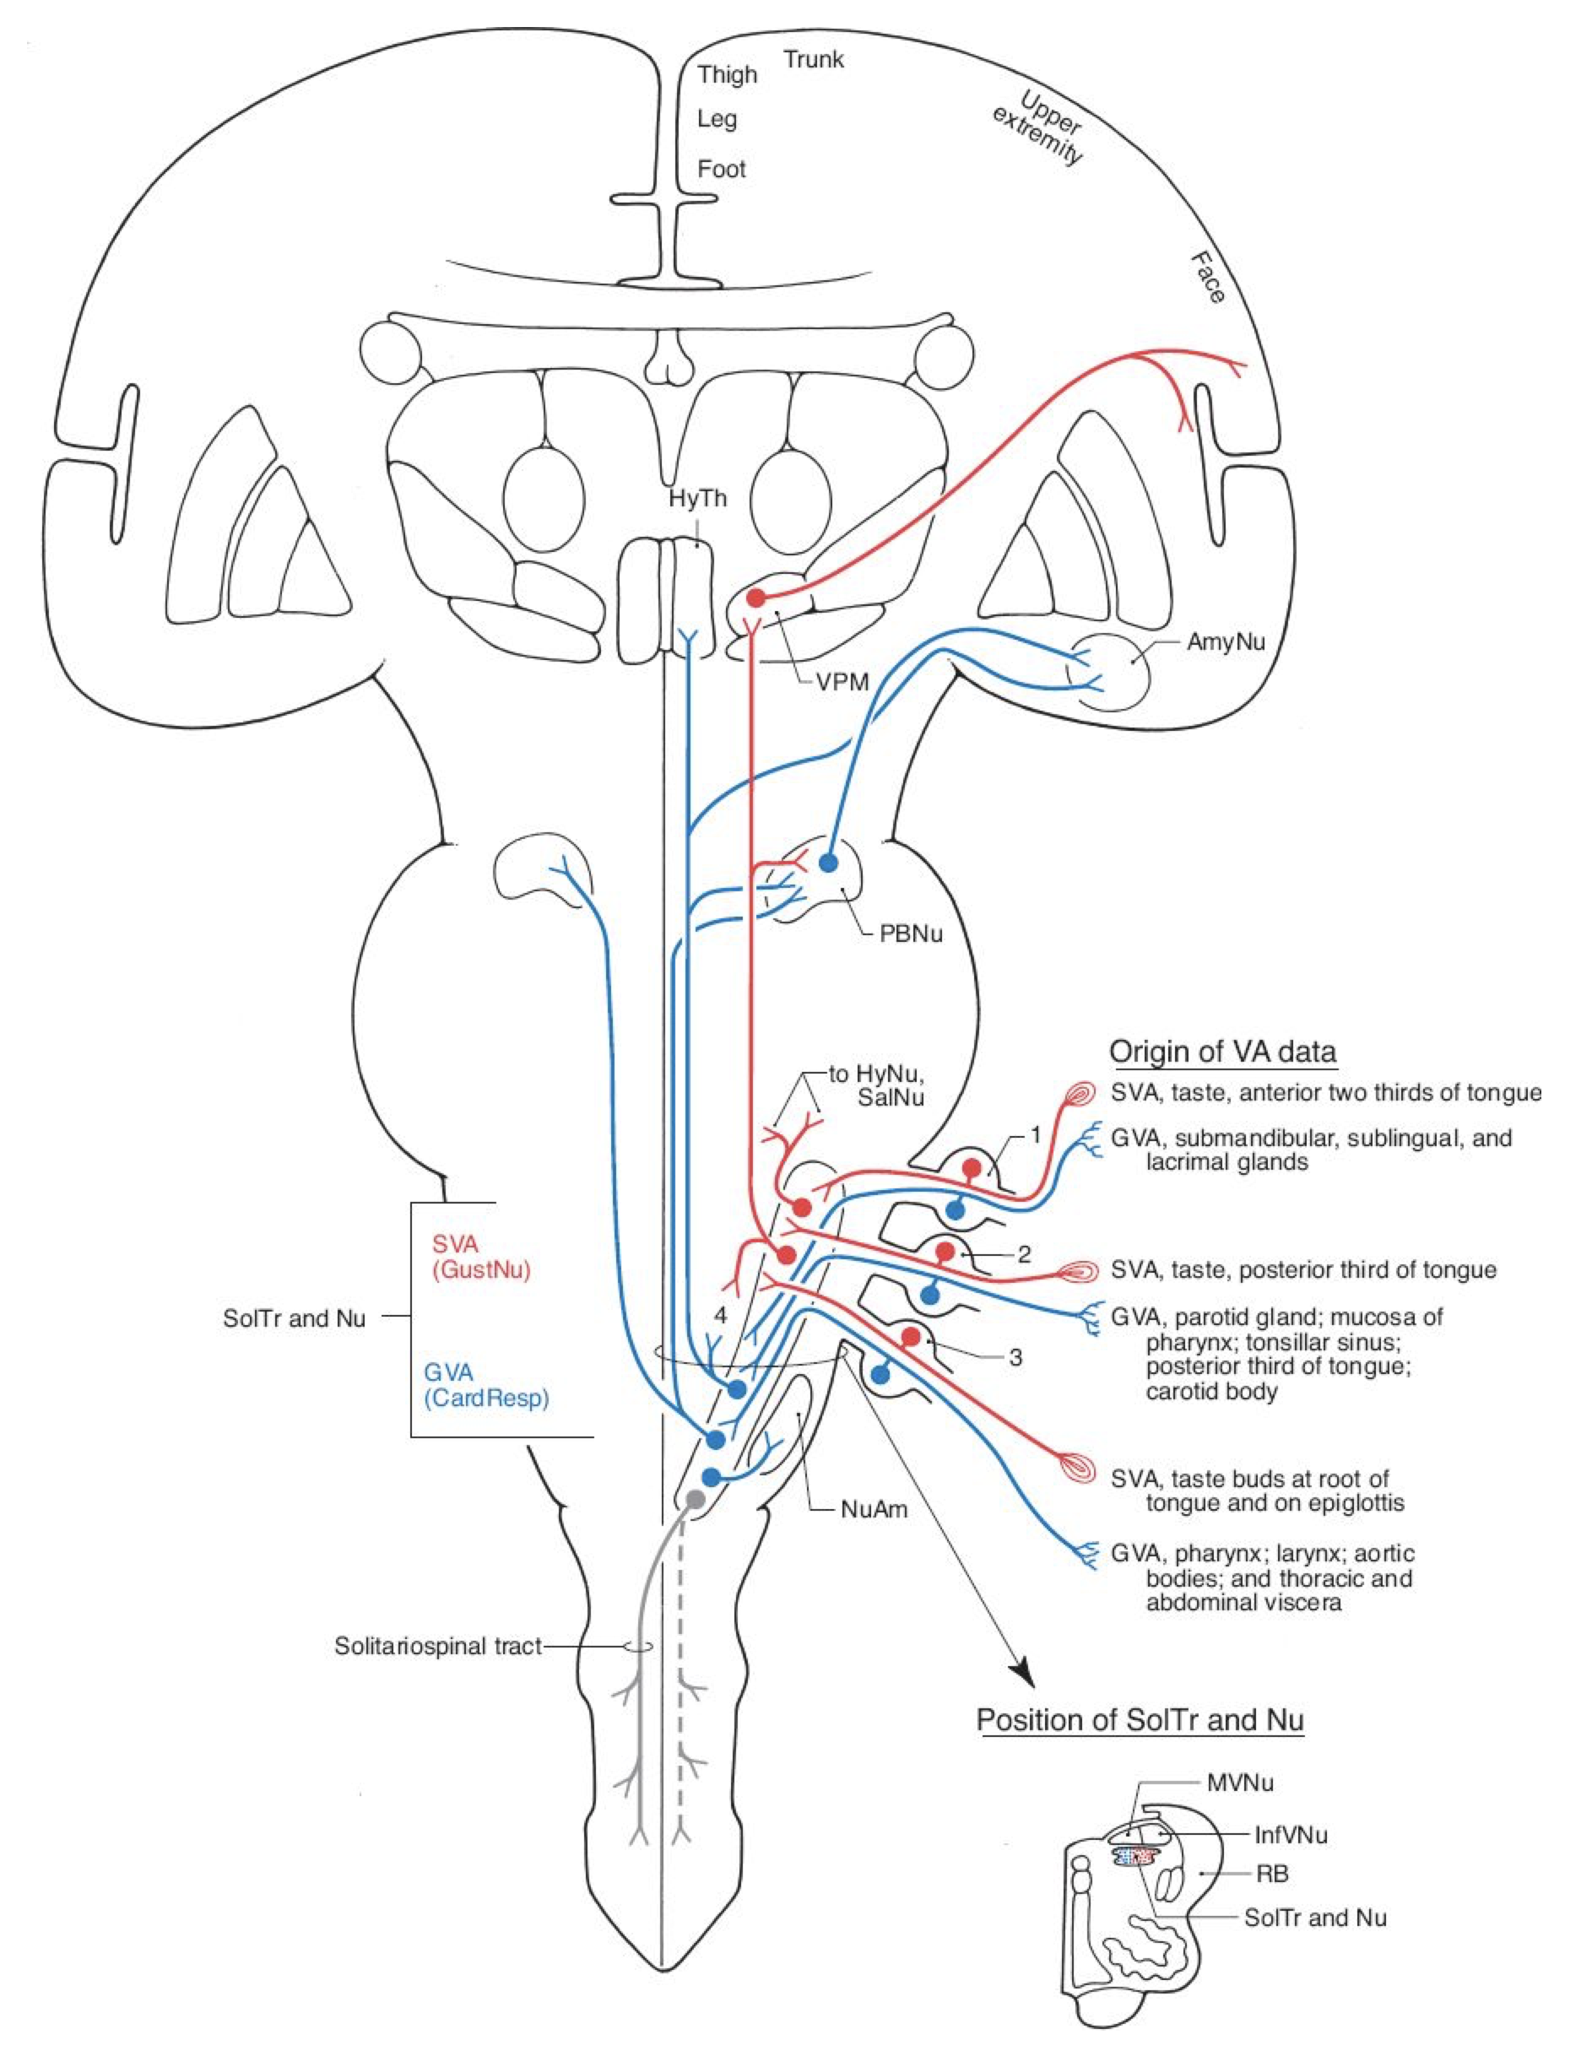
Lecture 03
Key nuclei
Viscerosensory
Nucleus tractus solitarius (NTS): viscerosensation, taste
Parabrachial complex (PB): viscerosensation, visceral pain
Visceromotor
Dorsal motor nucleus of vagus (DMN-X): Visceromotor, glands, organs
Nucleus ambiguus: Cardiovascular regulation, other immunoregulatory
Rostral ventrolateral medulla (RVLM): Cardiovascular regulation
Facial nucleus: Automatic facial expressions
Descending sensory modulation
Rostral ventral medulla (RVM): Regulation (up/down) of pain-related (nociceptive) input
CHOONG-WAN WOO | COCOAN lab | http://cocoanlab.github.io

Slide 19
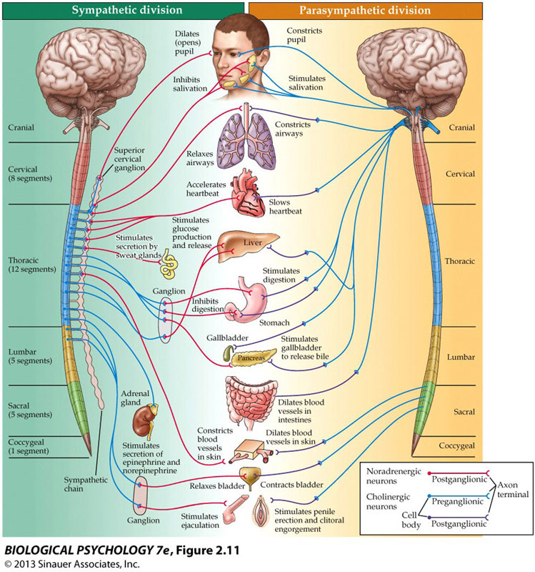
Lecture 03
Sympathetic and parasympathetic
Vagus (X):
a very important role in innervation of organs
Sympathetic and parasympathetic divisions are generally opposing:
sympathetic -> epinephrine and norepinephrine (NE)
parasympathetic -> acetylcholine (ACh)
Vagus nerve stimulation
increase parasympathetic input
intractable epilepsy
depression
CHOONG-WAN WOO | COCOAN lab | http://cocoanlab.github.io

Slide 20
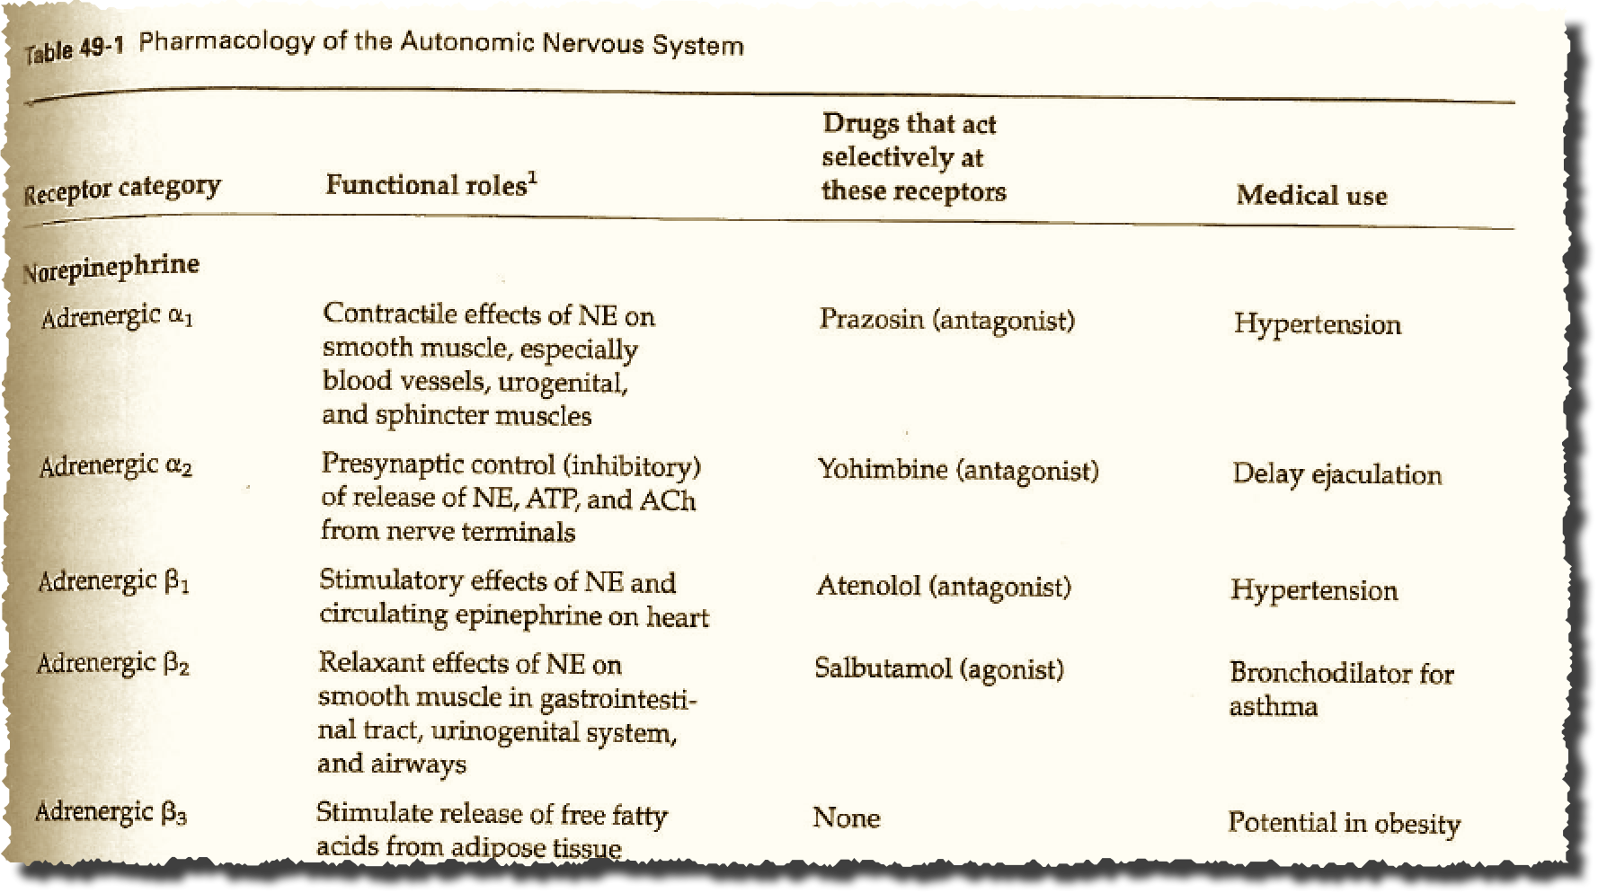
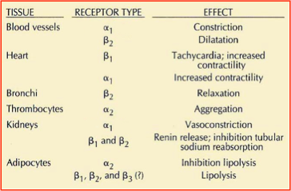
Lecture 03
ANS pharmacology I
Norepinephrine (NE) effects on multiple systems
Drug effects are complex: Receptors have different effects in multiple organs
NE alpha and beta antagonists (“beta blockers”) are given for hypertension
CHOONG-WAN WOO | COCOAN lab | http://cocoanlab.github.io

Slide 21
Lecture 03
Example: beta blockers
Many “…lol” drugs: e.g., propranolol
Relatively selective (or nonselective) for different receptor subtypes
b1
Central NE receptor
b2
Reduced anxiety
Reduced sleep
Across blood-brain barrier
b3
NE receptor
b1
heart
Bradycardia (slower heart rate)
propranolol
Sympathetic influences are pervasive (widespread)
Drugs are “dirty:” multiple receptors and systems
These systems originally exist to govern the body based on environmental and internal (motivational) context, not to respond to drugs!
Cognitive, emotional, behavioral effects may be less “dirty” – more fine-grained control!? e.g., relax without getting fat
b2
bronchi
Airway constriction
b3
Fat cells (adipocytes)
Weight gain
CHOONG-WAN WOO | COCOAN lab | http://cocoanlab.github.io

Slide 22
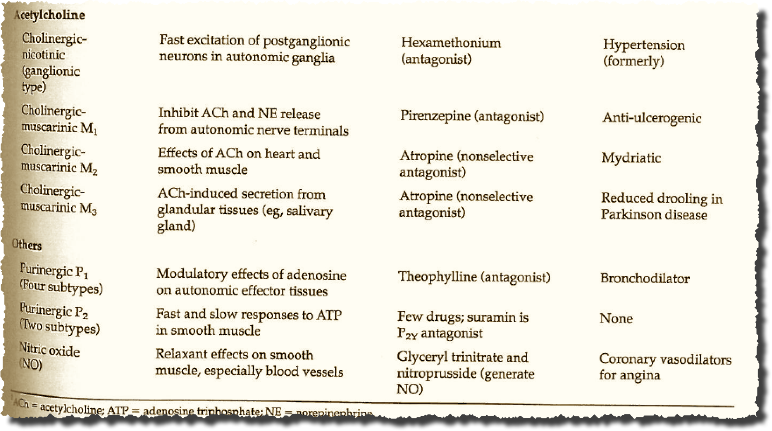
Lecture 03
ANS pharmacology II
Cholinergic drugs
Cholinergic (ACh) antagonists block parasympathetic, vagal actions, and thus increase pupil dilation, heart rate
CHOONG-WAN WOO | COCOAN lab | http://cocoanlab.github.io

Slide 23
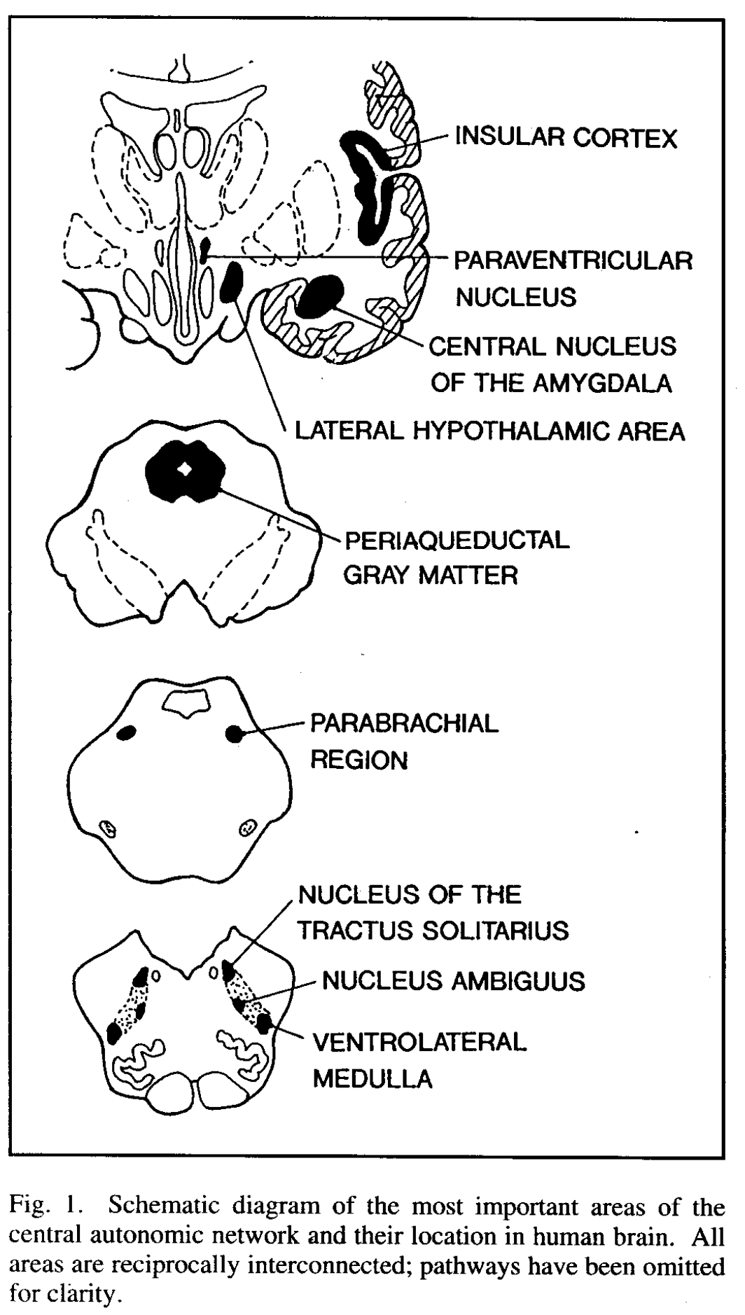
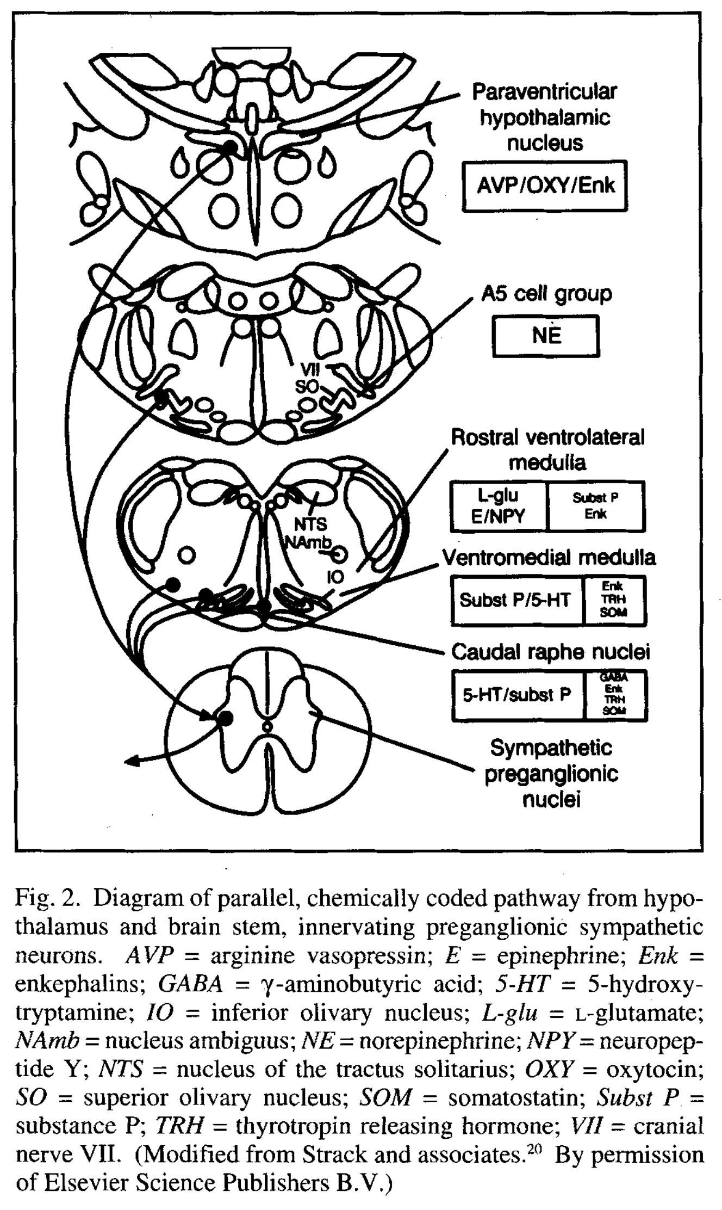
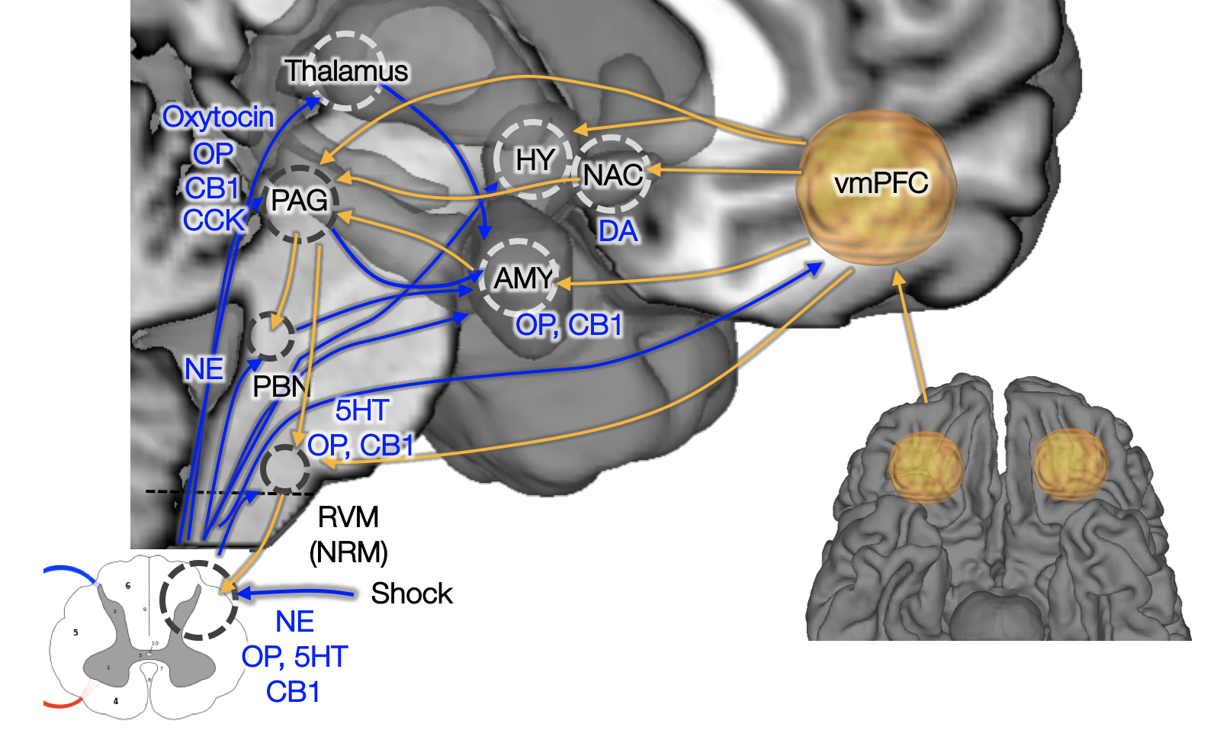
Wager (2015), Benarroch (1993) Lecture 03
CNS control of ANS: Visceromotor network
Descending projections from multiple systems
Critical areas: Hypothalamus, PAG, amygdala, and medial prefrontal cortex, etc.
Called the “visceromotor” network or “central autonomic network”
CHOONG-WAN WOO | COCOAN lab | http://cocoanlab.github.io

Slide 24
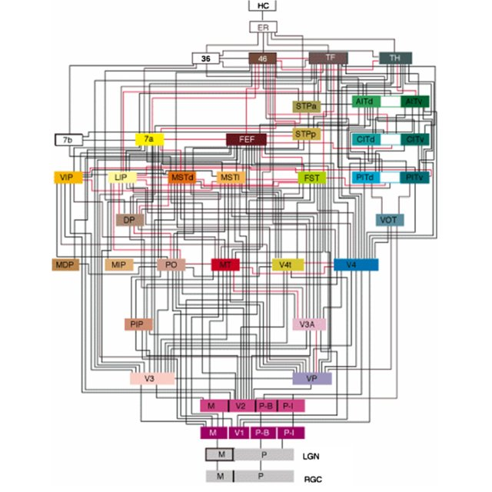
Wager (2015), Benarroch (1993) Lecture 03
CNS control of ANS: Visceromotor network
You might be familiar with this neural wiring of the visual system: (Felleman and Van essen, 1991)
But that’s not the only complex network
CHOONG-WAN WOO | COCOAN lab | http://cocoanlab.github.io

Slide 25
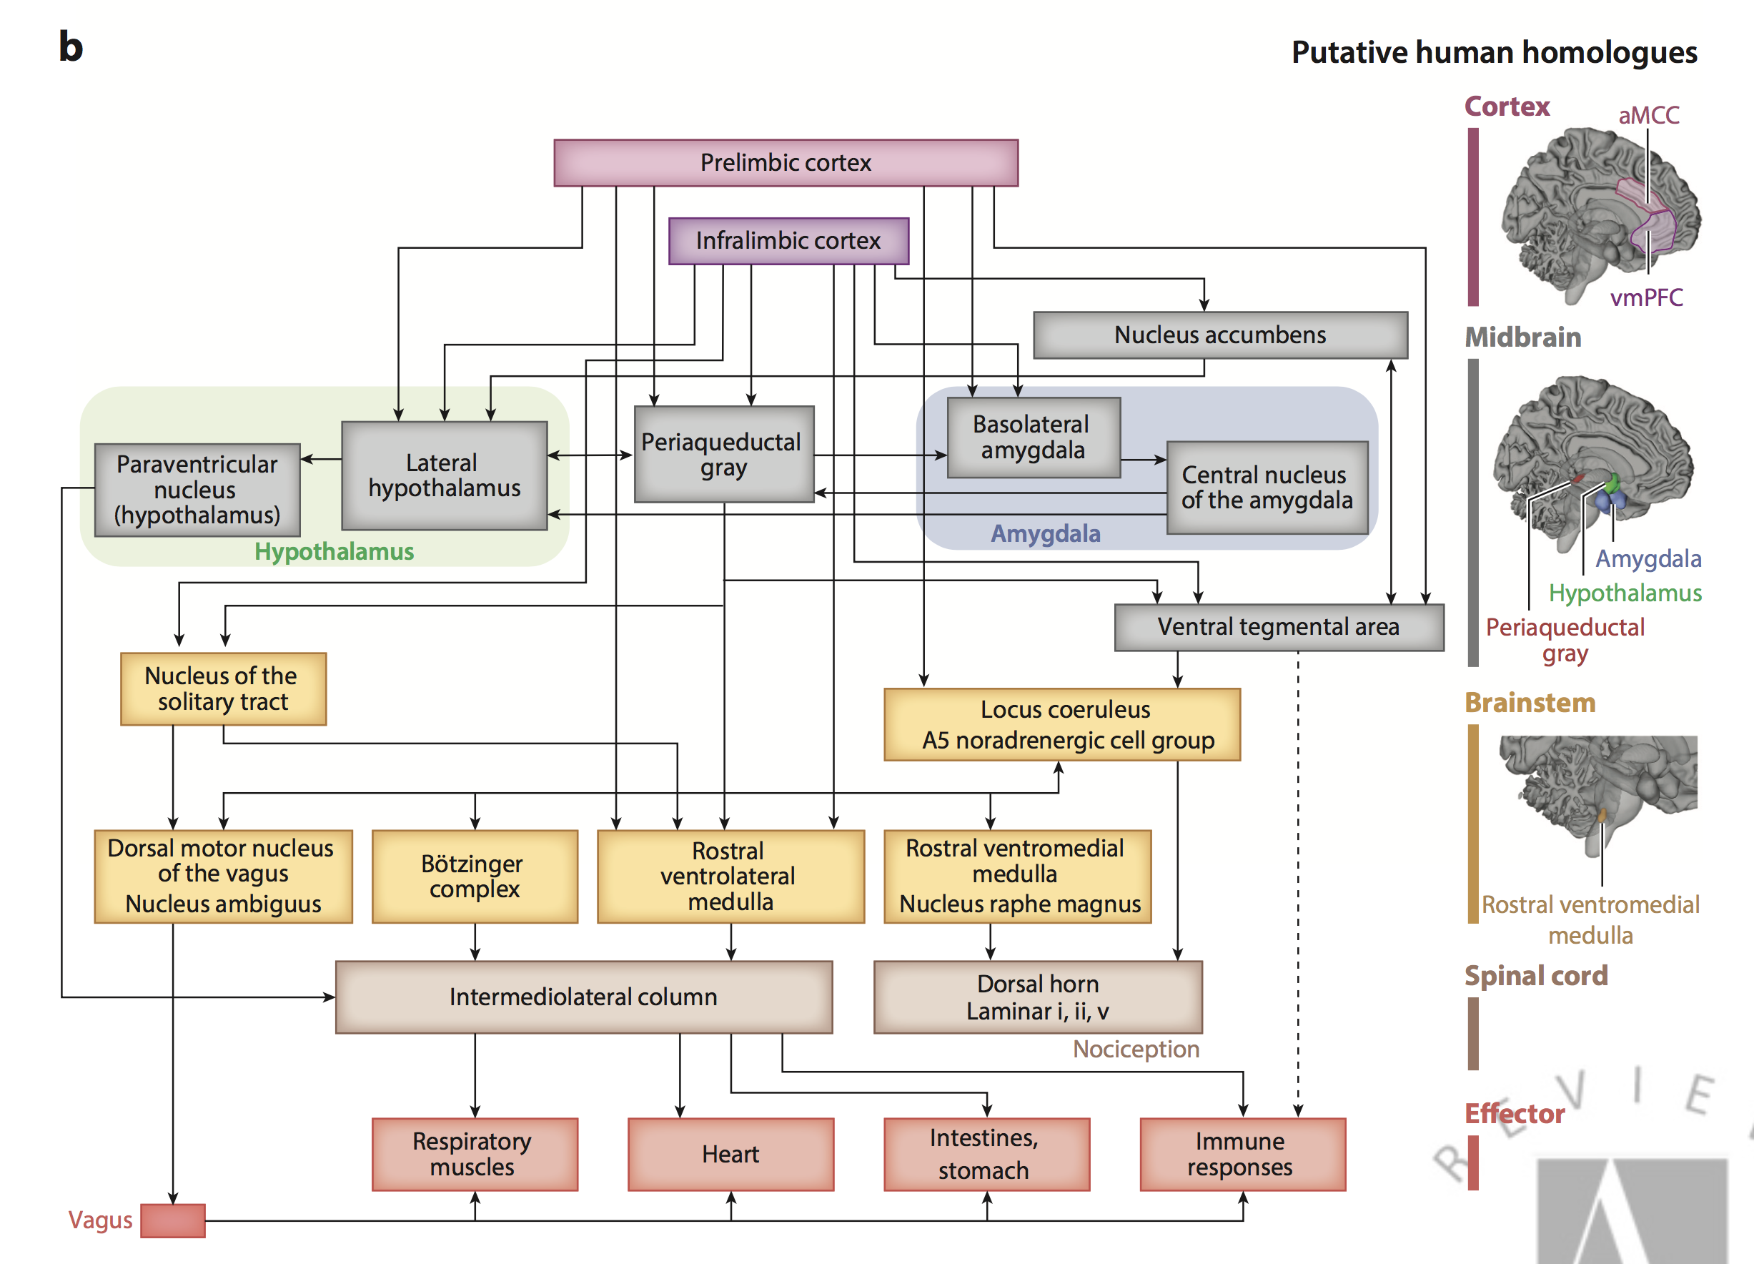
Wager (2015), Benarroch (1993) Lecture 03
CNS control of ANS: Visceromotor network
Medical cortical
visceromotor
system
Central opioid and 5HT system
Central NE system
Cranial nerve nuclei and others
Sympathetic output
Parasympathetic output
CHOONG-WAN WOO | COCOAN lab | http://cocoanlab.github.io

Slide 26
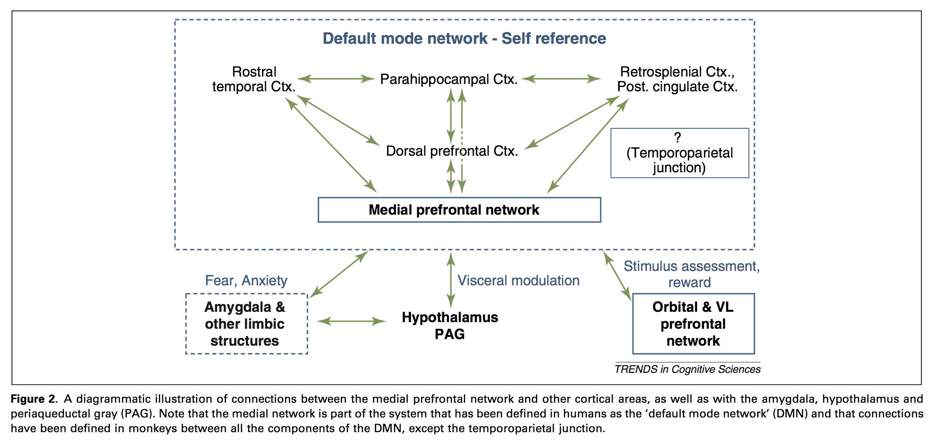
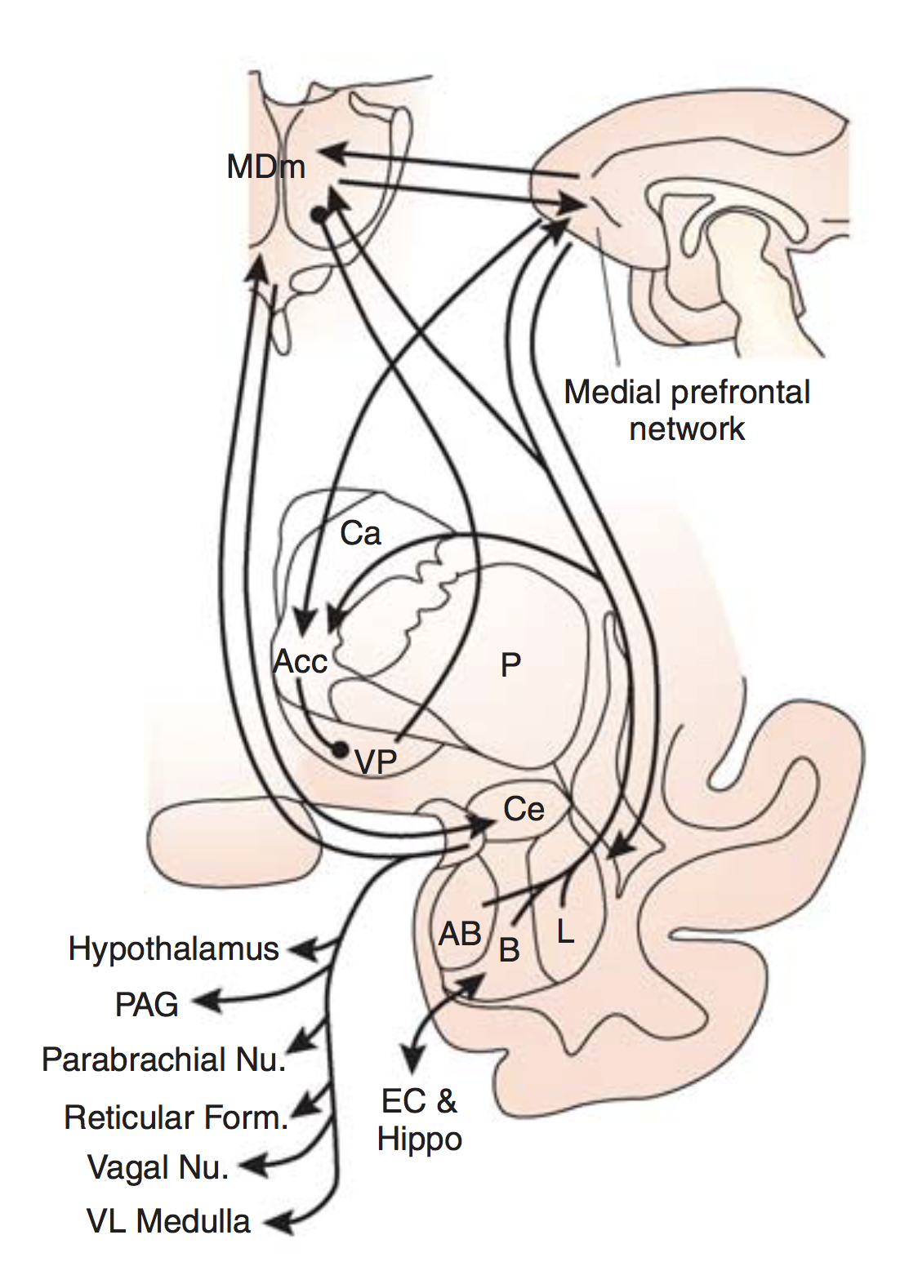
Price (2010, 2012) Lecture 03
Medial and orbital prefrontal network
CHOONG-WAN WOO | COCOAN lab | http://cocoanlab.github.io

Slide 27
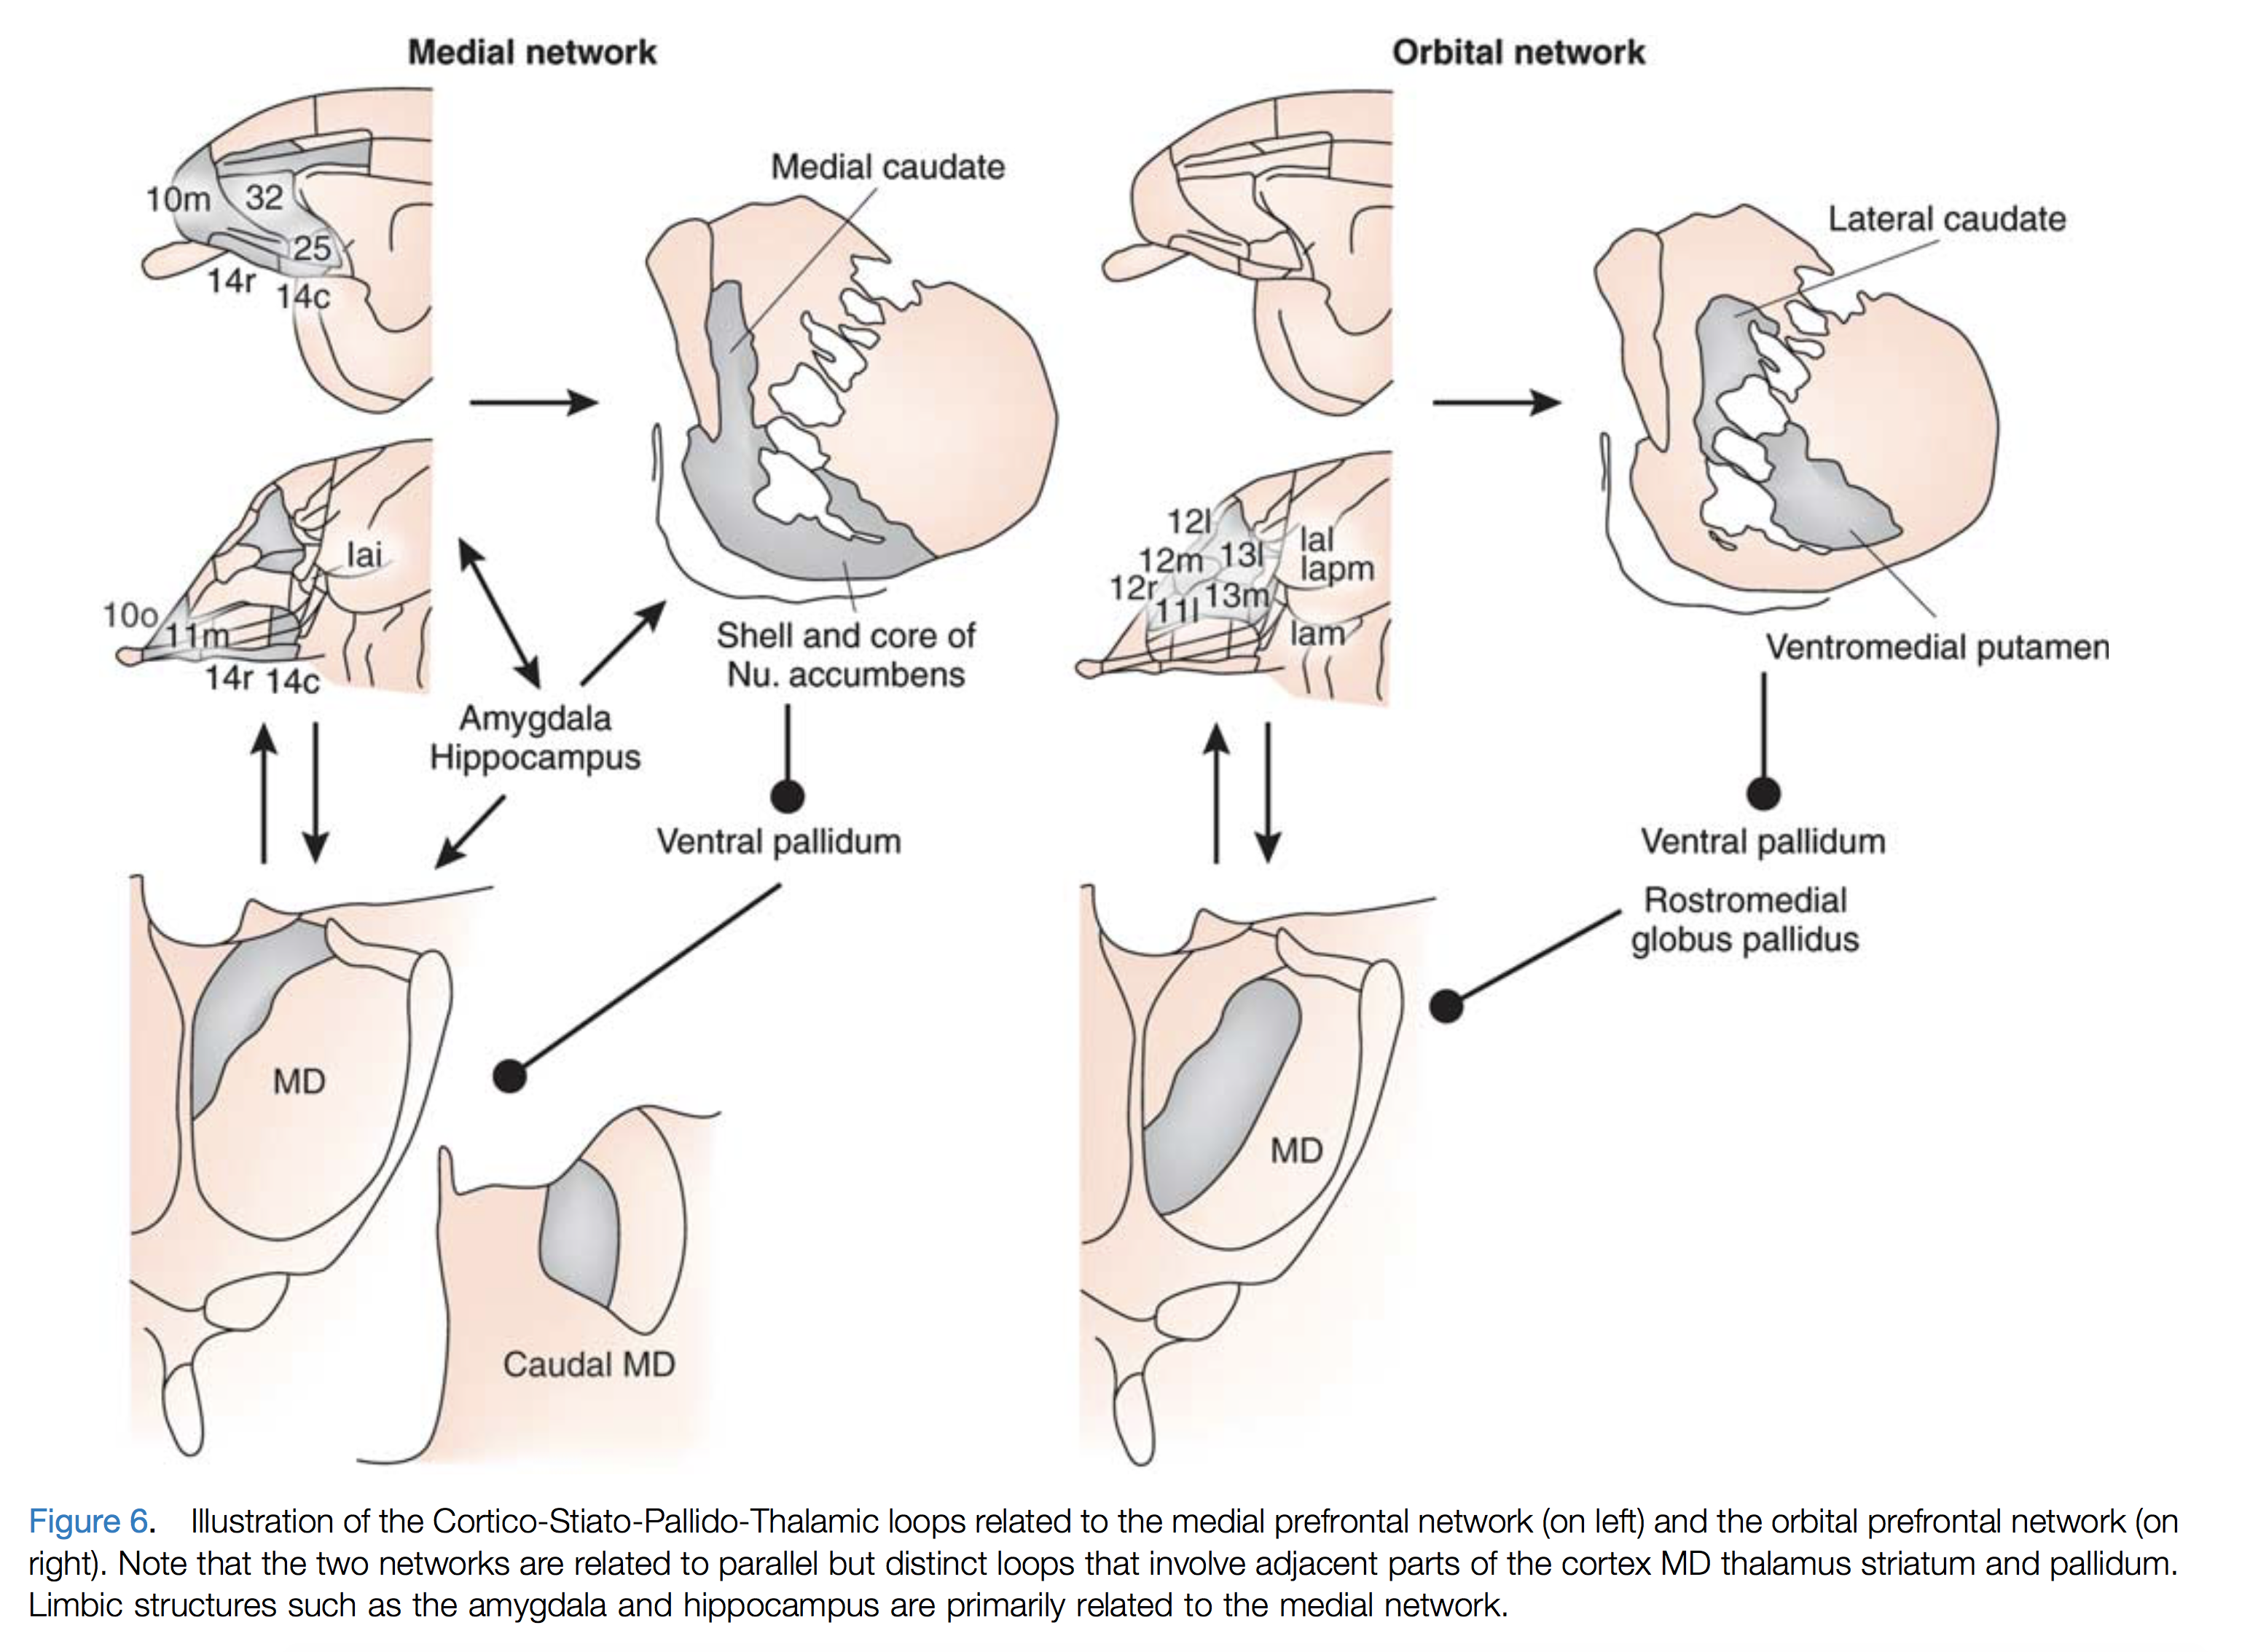
Price (2010, 2012) Lecture 03
Medial and orbital prefrontal network
Medial network: Visceromotor and ‘core affect’
Orbital network: Connects multisensory signals to medial network; other functions
CHOONG-WAN WOO | COCOAN lab | http://cocoanlab.github.io

Slide 28
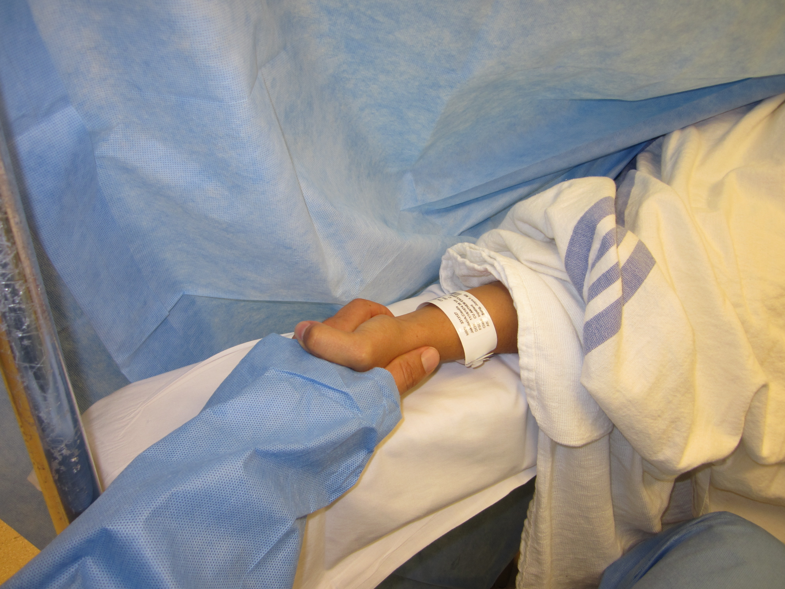
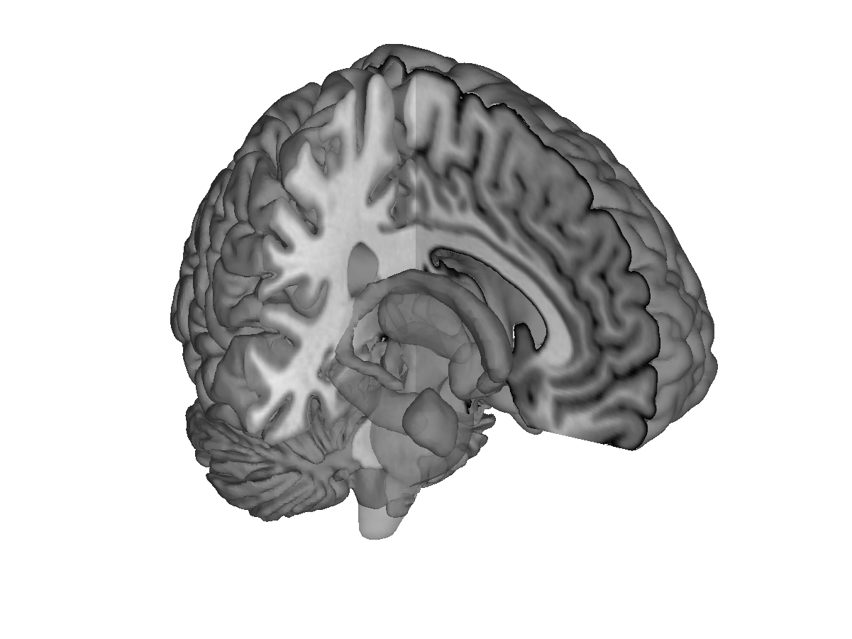
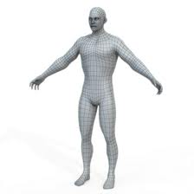
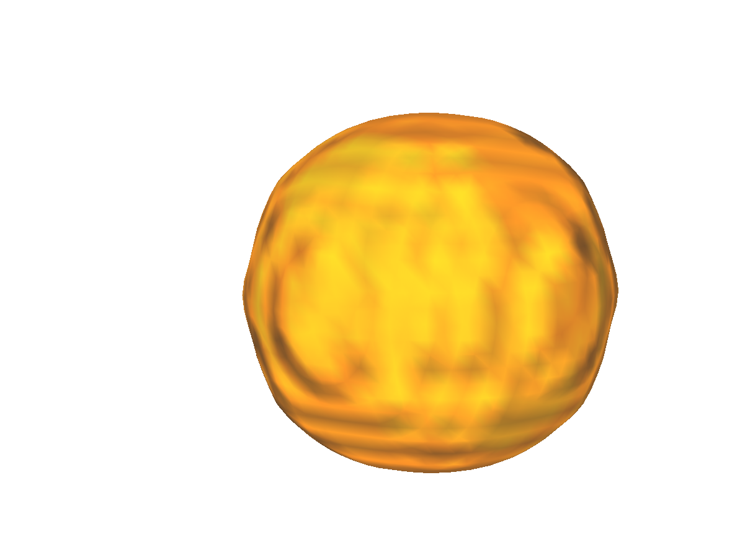
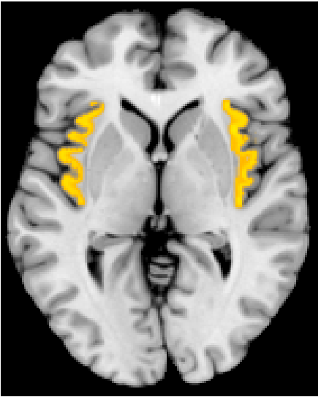
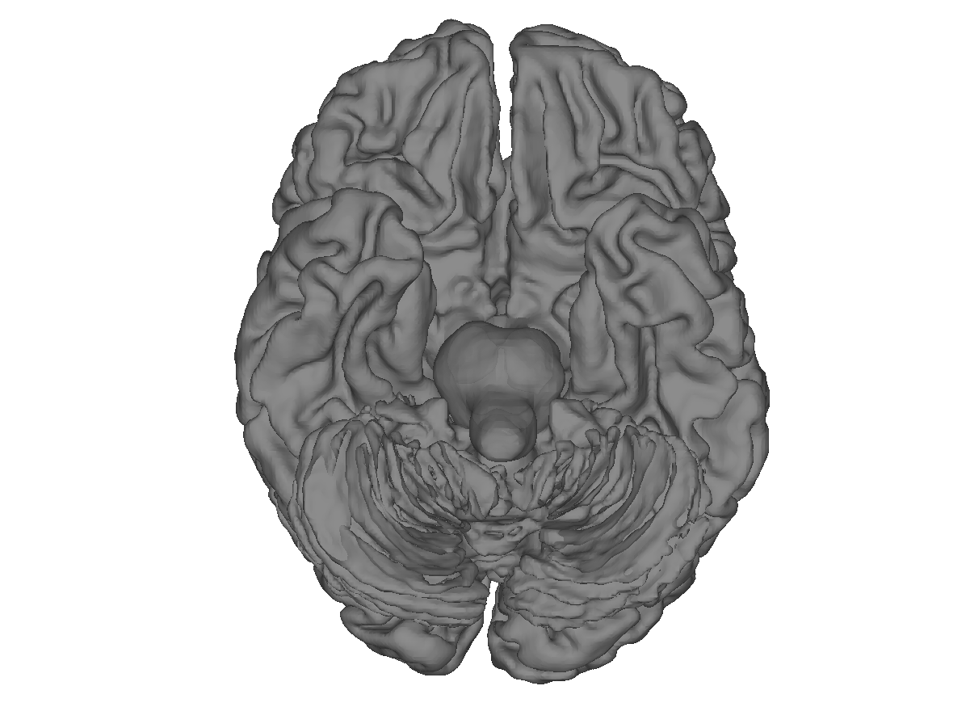
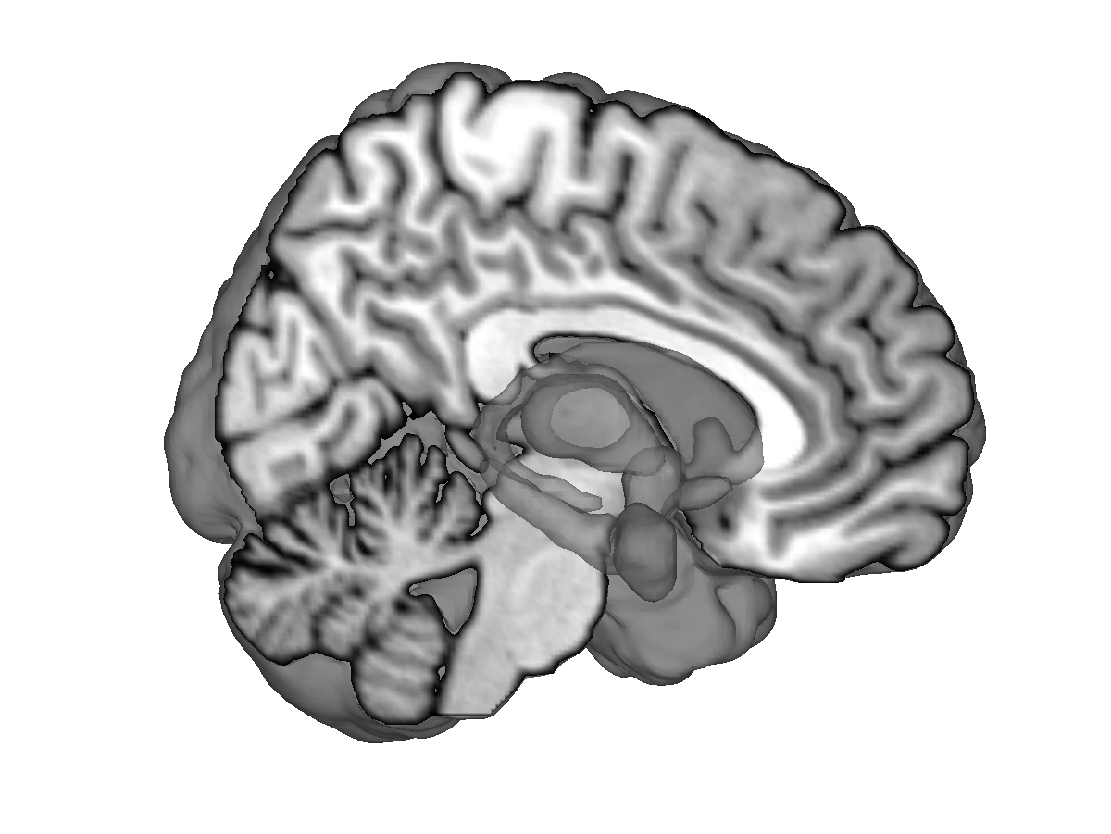
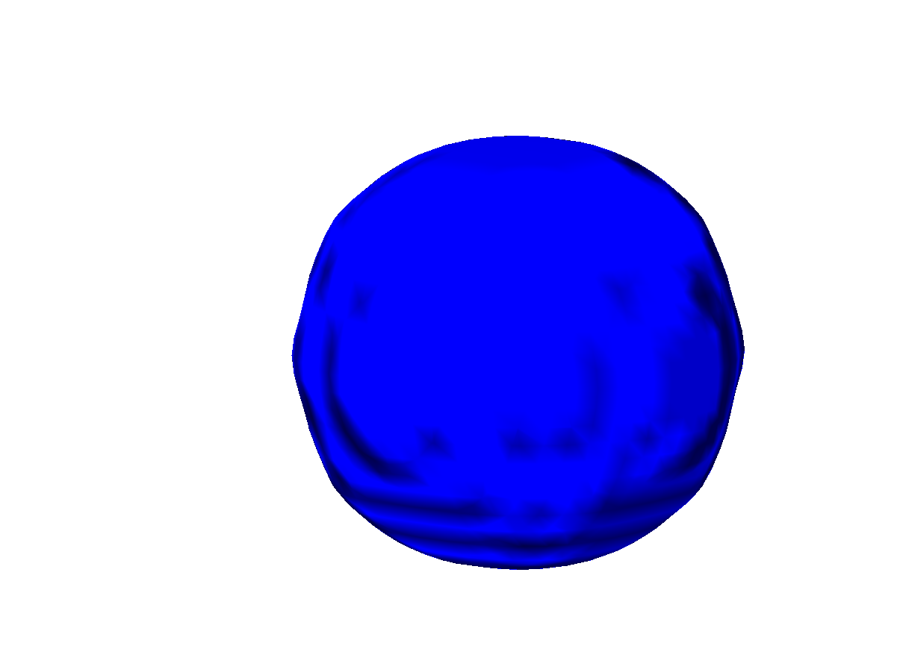
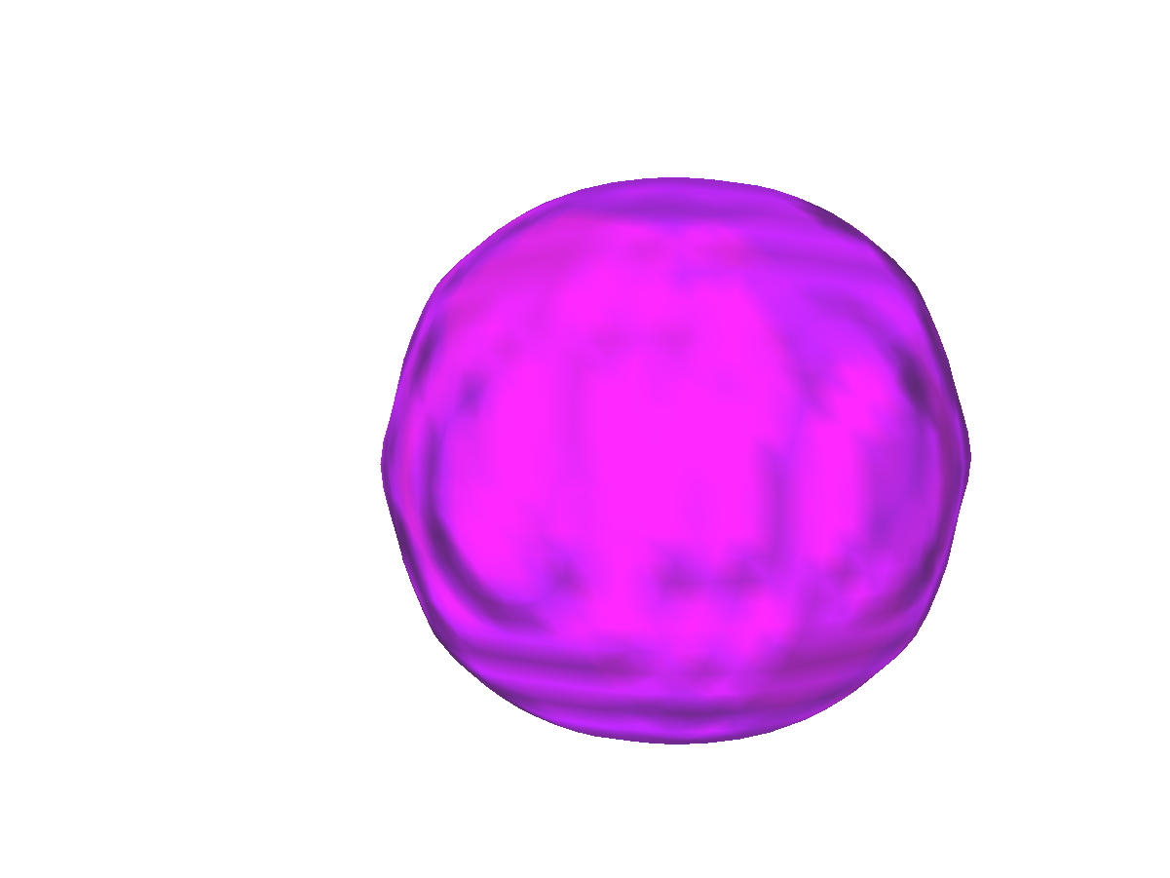

Lecture 03
Affective brain system
Conceptual pattern generators:
Situational schemas
Social context
DMPFC
Insula
Understanding emotion as visceral-affective-conceptual pattern generation process
Interoceptive
context
Memory, place context
vmPFC
Expected future events
Hipp
OFC
Affective pattern generators
Hy
Fight, escape, submit, pursue, recover, etc.
PAG
NAC
Amy
Visceral pattern generators
Thermoregulation, emesis, nociception, etc.
CHOONG-WAN WOO | COCOAN lab | http://cocoanlab.github.io
Wager & Atlas, 2015; Saper 2002; Bandler 2001

